Slide 1
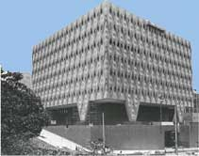
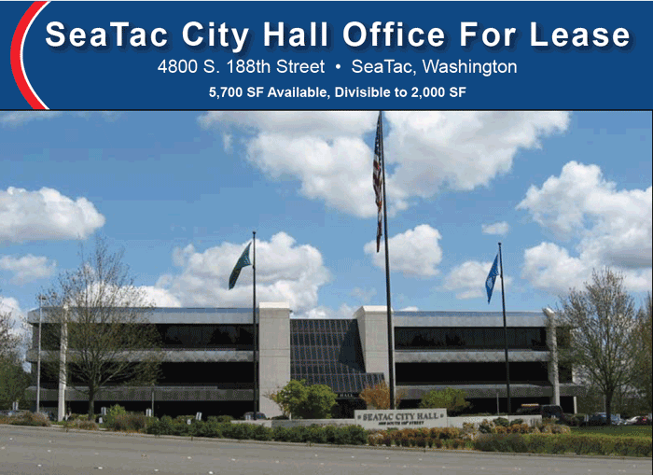
the dark side of municipal corporations – how they take private property so they can take more private property
King County Municipal Corporation
500 Fourth Ave.
Seattle, WA 98104
“The bird of paradise alights only upon the hand that does not grasp”
John Berry

Slide 2
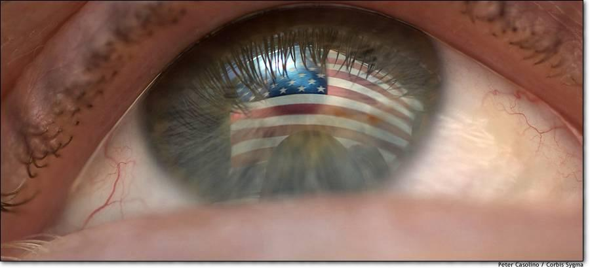
This presentation is formatted for At-a-glance viewing
This presentation has been set up so you may scan high points quickly at the level of your interest and time.
For quickest viewing simply scroll through the slides and scan the slide title, pictographs, e.g. pictures, charts and quotes to get the drift.
For more thorough viewing, you may thread deeper into the research material to make your own conclusions at your time and interest.
Property takings are more often devious and deceptive but certainly not “rocket science”.
Please do not be overwhelmed by the detail, this is provided to help questioning minds separate the fact from fiction at least in the time and manner I can provide.

Slide 3
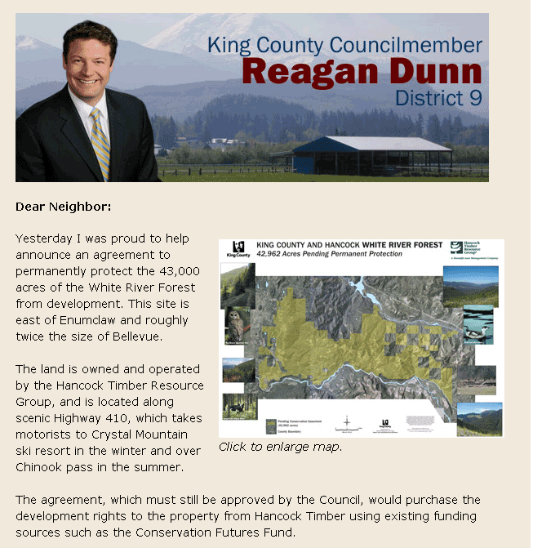
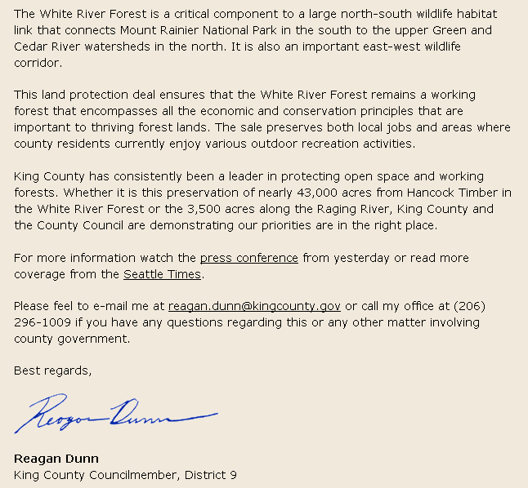
Dunn & dow white river forest happy talk taking
The “funding sources” are property tax set asides stolen from each local property owner without their direct approval or knowledge. Property taxes cannot be taken at all and are absolutely fraudulent and have been challenged in several states. Private property is allodial land held by the sovereign and free state Citizens, it is also their individual and family life savings of their labor and wages including their small businesses. No one can put a political, environmental or real gun to a state Citizens head, property or labor and demand they pay for the latest political taking fad for the “common good”. The highest fundamental principles of our land, i.e. LONANG, the Declaration of Independence and the spirit and success of the first American Revolution cry FREE CHOICE out paid for already with our blood, sweat and tears!
Link below to see 42 U.S. Supreme Court rulings directly against taxing (taking) labor and property and 11 Federal Circuit court Cases, table at top of page - http://www.freedomforallseasons.org/FreedomFromALLTaxes.asp
“The intelligent man who is proud of his intelligence is like the condemned man who is proud of his large cell.
Simone Weil

Slide 4
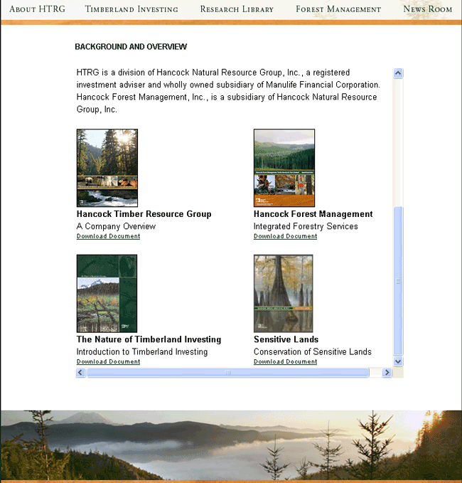
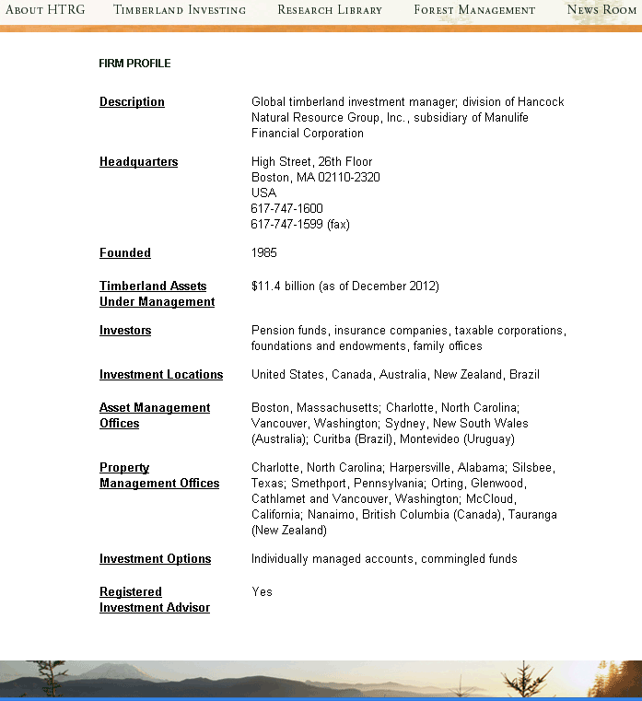
The Hancock timber resource group connection to the globalist
We are the world's largest timberland investment manager for institutional investors, serving both domestic and non-US clients.
http://www.htrg.com/about.htm
HOW THE GREEN LAND GRAB GAME IS PLAYED
Manulife Financial Corporation is the holding company for Hancock Timber Group. Manulife is a Canadian insurance conglomerate which merged with U.S. based John Hancock Financial Services. They are the largest life insurer in Canada and the second largest in North America and fifth largest in the world. They are spread out in Asia, Canada and the United States and have assets of US $ 512 billion. They are also connected to Manulife Bank which is a Canadian Bank.
This is global institutional conglomerate whose stock is probably held by at least one state agency, municipal corporation pension fund, etc. One would have to comb through every municipal corporation CAFR in WA State Inc to see if there were any investment collusion involved.
The nature of this NGO goes like this. They troll the globe and work the green extreme circuit for profit, i.e. the 3,141 U.S. county municipal corporations and the thousands of city municipal corporations, most especially the large ones like King County and City of Seattle Muni. Corp. especially the NW and Rocky Mountain regions where land is ripe for the green taking.
As you see above, global green NGO’s mirror what the greedy public corporations want by showing they specialize in “Sensitive Lands”. Then the liewyers on both sides make a backroom deal which is mutually profitable to their corporations at the expense of local property owners which are sent to the cleaners using property tax taking extortion shoved down the public throats.

Slide 5
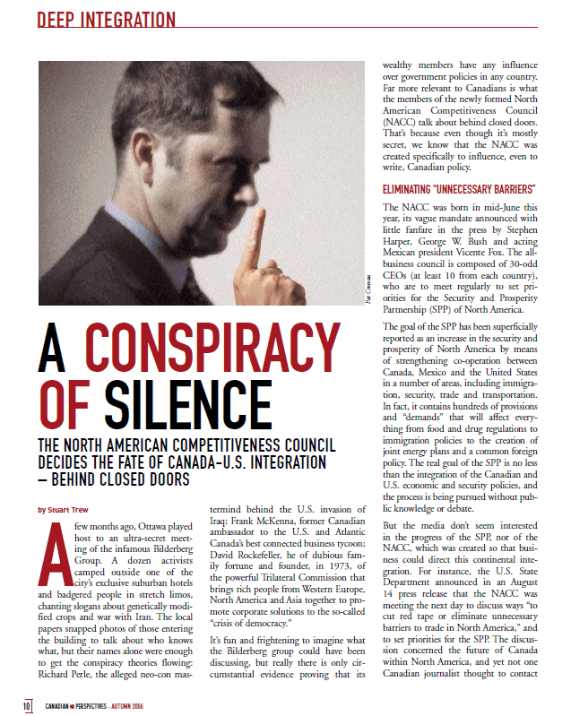
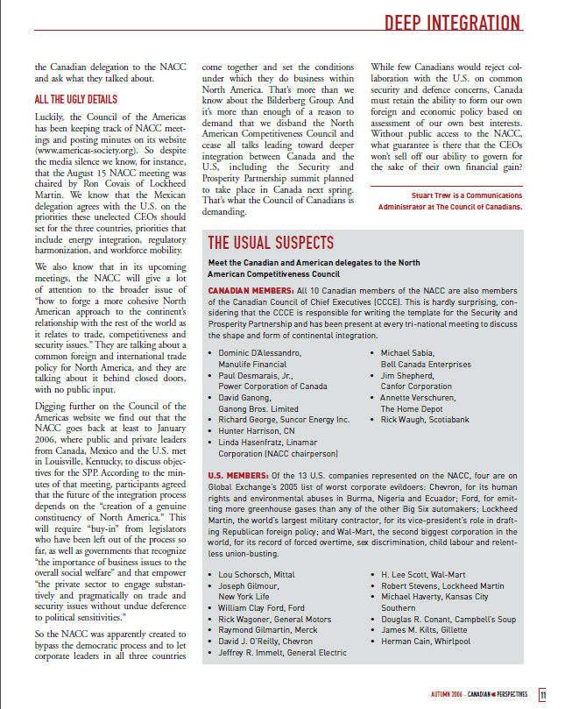
Manulife financial (hancock timber resource group holding company) is a member of north American competitiveness council and helped write the security and prosperity partnership (one world government for north America) – must read
Link here to better view this report - http://www.canadians.org/publications/CP/2006/autumn/CP_Fall06_DI.pdf

Slide 6
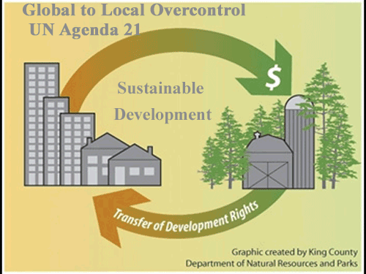
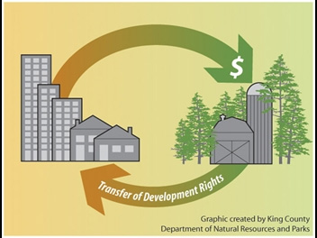
Martin Luther King County Washington municipal corporation vicious cycle of taking
“To turn one’s back on delusion is to attain to the ultimate; to attain to the ultimate is to attain to the origin.”
Tao-Ch’ien, Zen Calendar, February 5, 2013
No More Muni Corps = No More Taking of Property
Taking wages via property taxes in exchange for nothing of free market value
Transferring small time property owner wages to large NGO corporation
As advertised by King County Municipal Corporation
http://www.kingcounty.gov/environment/stewardship/sustainable-building/transfer-development-rights.aspx
What King County Municipal Corporation Collectivist Council and Their Planners Intentionally Left Out in This Chart
“The ego, being a flimsy construction and being bound up in time and space, will have to fall apart. The ego, in fact, continuously falls apart and has to be reinforced by vanity, greed, jealously, and evil.“
Janwillem Van Der Wetering

Slide 7
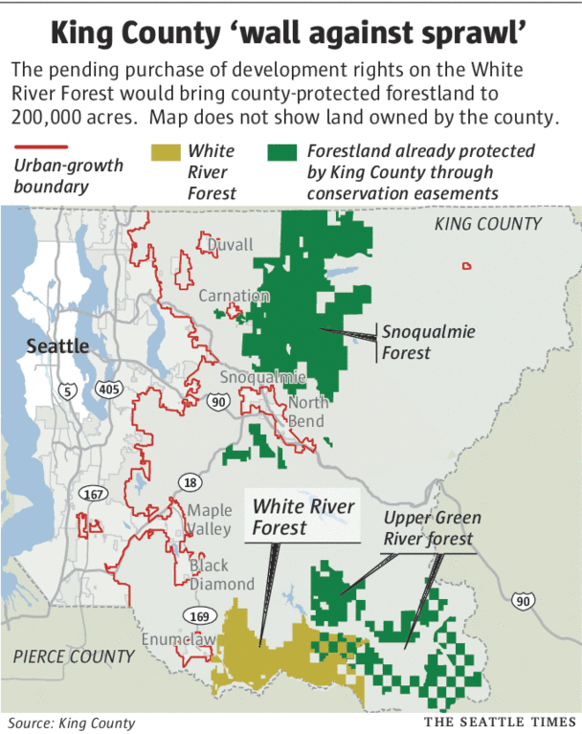
Wall of sprawl of municipal corporations
Public Municipal and Private Corporations , A Catalytic Combo Punch to Property Rights
Government owned natural resources are meant to provide revenue and honest jobs to the individual state Citizens for a limited infrastructure not for unlimited government taking. This simple basic righteous concept means government does not acquire natural resources by taking wages especially for environmental expansion fantasies. Property taxes are clearly unconstitutional as they are not apportioned and they are clearly forbidden by the higher laws of our land all together. You cannot tax sovereign state Citizens property or wages at all. Laws of Nature and Natures God (LONANG), the Declaration of Independence and the spirit and success of the first American Revolution are very clear about this.
King County Municipal Corporation of WA Inc. is the 14th largest county in the nation of 3,141 counties and in a state where the federal government owns at least 33% of the state land while King County Municipal Corporation wants more land at a cost no property owner can afford just so Hancock Timber cannot build on it. All while most county municipal corporations around Puget Sound rat pack its subdivisions for profit and power, i.e. wall to wall municipal sprawl.
I count 113 properties on King County Municipal Corporation's Foreclosure list. You can add to this heartless and needless takings thousands more if not tens of thousands of hardship cases this public corporation is creating by continually escalating these type of needless and debased land takings on the back of the property owners. You will see more takings by this greedy municipal below who has shut down homes and small farm business because they do not meet some code no home owner ever agreed to let alone can afford. The county says they have set aside funds to buy more land with one hand while the other is throwing poor families into bankruptcy and into the street. I have one old friend and ex neighbor who recently moved to Idaho because the property taxes in King County were one third his pension. Another friend is paying $18,000 a year for the pleasure to live in his home. We are also leaving.
Taking of land via "development rights" using property taxes has nothing to do with "sprawl" as the global to local state municipal monarchy has defined it, i.e. the occupation of the natural born sovereign and free state Citizens upon their own land. This labeling with intent to take by defining living on your own land is equivalent to persecuting witches and will be realized so in a few years as a critical mass of Americans wake up to this green wet dreams. This "wall of STRAW" is a global to local front line being staked out in every state and larger city and county municipal corporation. These stakes come in many colors and many pretty labels, e.g. smart growth, growth management, sustainable development, conservation easement, wilderness, wetlands, critical areas, sensitive areas, endangered species, alternative energy, ad nausea.
The Seattle Times article above sanctions King County Municipal Corporation putting a gun to the heads of its Citizens and property owners to extort some $33 million for 421,000 acres of land for a "wall against sprawl" all while most of us struggle to stay alive, find a job, keep food on the table and keep our homes or just give up and get out. What the Seattle Times is really saying is any growth of the municipal corporation is good growth because growth of government supports their declining readership by forcing everyone into the city while providing the illusion of more public forest where we have too much unproductive land already.
“You are lost the instant you know what the result will be”
Juan Gris

Slide 8
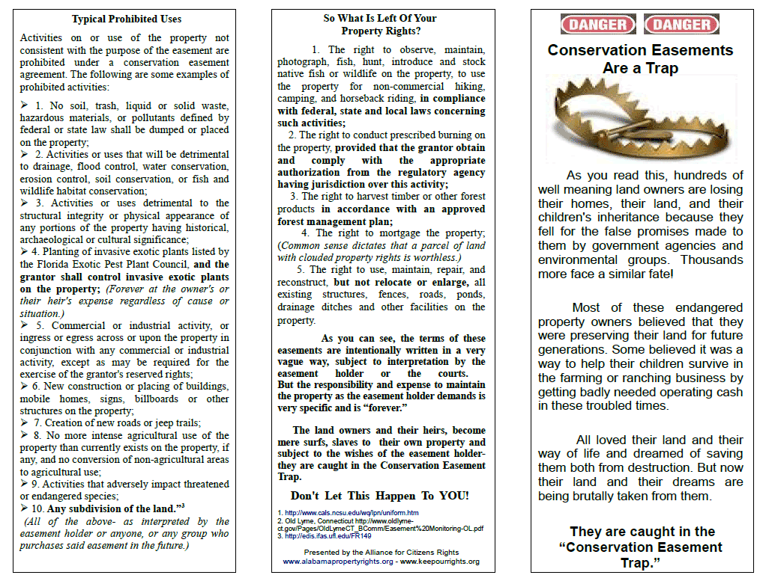
Conservation easements are a trap
“The best use one can make of his mid is to distrust it.”:
Francois Fenelon

Slide 9
International Council for Local Environmental Initiatives (iclei) i.e. property rights takings
“Sickness is a defense against the truth”
A Course in Miracles
Over 600 American Cites and Towns Taken
View All American Cities & Towns Taken by UN Agenda 21 - Then If YOU see your city & call your mayor and council, tell them to get out of the global to local centralization and taking of private and public property.
2013-04-04 DeWeese Report From Front Line Regarding American Communities Throwing Out ICLEI
2013-04-01 Power of Local Municipalities
2012-12-23 Alabama Protects Citizens From Agenda 21 Implementation - Investors_com
2012-11-19 Late Post Opinion Misguided land-use regulations push middle class out of King County Seattle Times Newspaper
2012-11-18 Activist Post WA farmers block federal drones and Agenda 21
2012-10-10 Rejection of UN Agenda 21 Ramping Up Weekend Morning Buzz
2012-09-22 Democrats Against UN Agenda 21 See My Comment on Steve Tharinger's Facebook)
2012-09-20 Prison Planet_com » UN_ Conquers Texas
2012-08-29 White House Executive Order On Rural Council
2012-08-29 UrbanSurvival170Gallons
2012-07-11 Agenda 21, UN's Sustainability Measure Banned By New Hampshire House
2012-07-11 UN Unveils Agreement Detailing global Governance
2012-07-11 UN Unveils Agreement Detailing global Governance
2012-02-03 Is Urban Planning Creeping Socialism
ICLEI Washington Cities
ICLEI Montana Cities
  Bozeman
  Helena
  Missoula
Bellevue
Bellingham
Bothell
Clallam County
Coupeville
Edmonds
Everett
Island County
Issaquah
King County
Kirkland
Lacey
Lynnwood
Mercer Island
Oak Harbor
Olympia
Port Townsend
Redmond
SeaTac
Seattle
Sequim
Shoreline
Skagit County
Snohomish County,
Spokane
Tacoma
Thurston County,
Tumwater
Whatcom County

Slide 10
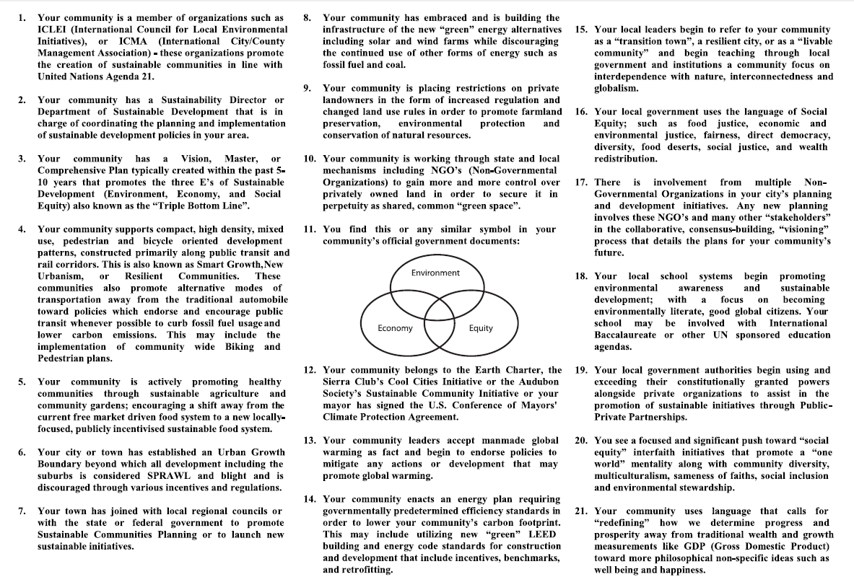
21 signs your community has been infested by un agenda 21
“Enlightenment is not imagining figures of light but making the darkness conscious.”
Carl Gustav Jung, Zen Calendar, 4/7/2013

Slide 11
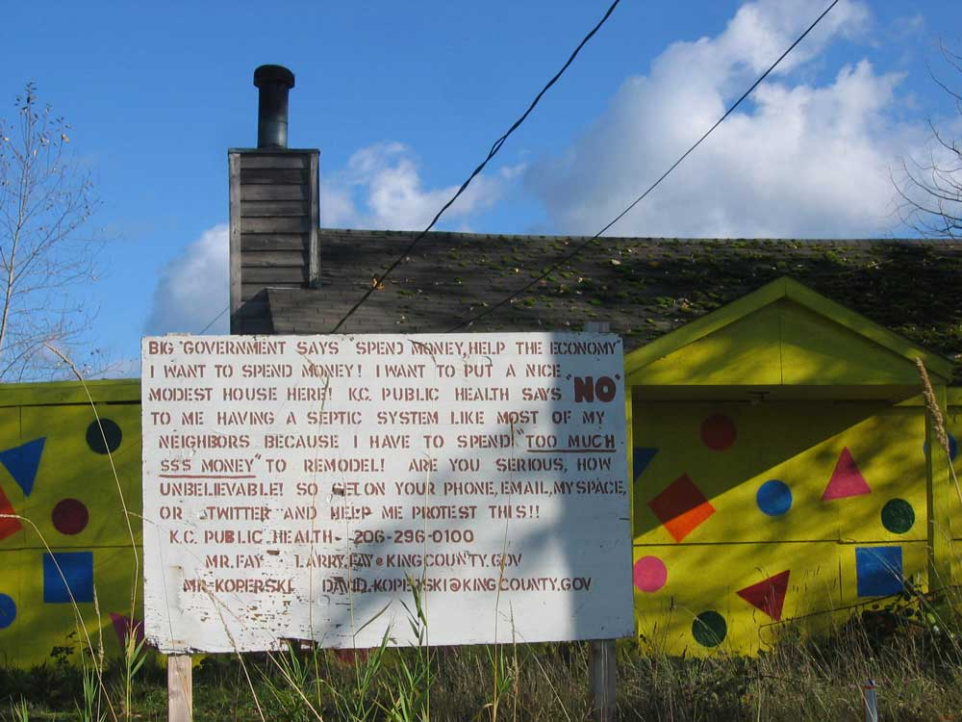
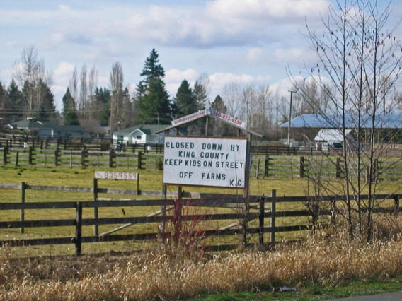
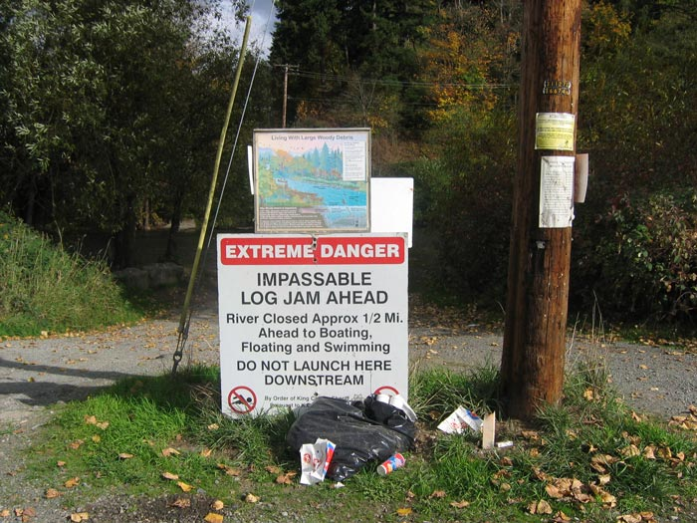

Just a sample of the private property takings by king county municipal corporation Inc. next door to Enumclaw Washington
“The mission of Bodhidharma’s journey to the east is to find a man who will not be deceived by men…. Here in my place there is no truth to tell you. My duty is to lighten the heavy burden of dead weight on your back. My mission is to free men from their bondages, to cure the sick, and to beat the ghosts out of men…
I-Hsuan, Zen Calendar, February 19, 2013
Here is another example of the criminality of King County Municipal Corporation State Inc. This poor home owner is about 5 minutes from me. While these political and legal hacks in the county steal our wages for their wet dreams for more land, they are systematically plundering the local property owners off their land and homes and businesses. People like Reagan Dunn and his council cronies can glad hand buying up 421,000 acres for $33 million while they put a gun to the head of this home owner and uncountable others for the want of a $20,000 new septic and drain field or whatever the current code is they make up for more revenue.
Five minutes from this poor home owner this same King County Monopoly spent $5 million to reroute the mouth of a tiny creek called Boise Creek while shutting down a farm family near me for offering good clean farm entertainment to families.

Slide 12
Enumclaw municipal corporation Pats King County Municipal on the back - says thank you for taking more private property on the backs of local property owners vs. contrasting reality
“The best use one can make of his mind is to distrust it.”
Francois Fenelon
Contrasting Reality Example - MORE PRIVATE PROPERTY/AGENDA 21 CONCERNS
Robert Burton's Story:
“I am just across the state line in Florida.. You may have heard of me...I am under attack by Senator Charlie Dean and other officials in concert with at least three UN NGOs for exposing many official hands secretly facilitating Agenda 21 while telling constituents and the news media, they have no idea what I am talking about.
I have been exposing that their campaigns are endorsed and funded by the UN NGO Network. I have exposed that they are committing Sherman Act and Clayton Act violations in concert with International Corporations to take over entire US based industries. That they are using the Mitigation Credit Bank to leverage private land to assimilate all natural resources toward Agenda 21 development schemes.
For my expose ,my home was raided and most of the evidence I have collected was stolen by Florida Department of Law Enforcement. Most of my You tubes were pulled from the air.
Currently I am being maliciously prosecuted for wire tap charges because I recorded Dean's Chief of Staff in the commission of his official duties ,and with his consent and posted his Agenda 21 lobbying admissions to You Tube.
The You Tubes below will show what I have been doing in Miami Dade with ICLEI Harvey Ruvin. If you watch them you will see why they want me silenced.
In 05-6 I was successful in ousting GARDC Comprehensive development planning from Echols County with the land owners by educating them to the UN being behind what was happening to their property rights. The Echols County Attorney ( Warren Turner) was Georgia Conservancy and is operating in Lounds. Sherry Davidson (GARDC) is still your regional affiliate for Agenda 21.. They are Umbrella-ed under NADO National Association of Development Organizations and other UN NGOs. They are the consulting organization for Lounds and Valdosta”
Robert Burton's Research (Must View)
http://www.youtube.com/user/VFiveVs#p/u/4/OIepbIsdCnA
http://www.youtube.com/user/VFiveVs#p/u/3/k-kMhEYXNrA
http://www.youtube.com/user/VFiveVs#p/u/2/21vx9_iZSWw
More here: http://www.freedomforallseasons.org/MunicipalCorporationsMaterial/2011-09-23%20Supreme%20Court%20Decision%20On%20Private%20Property%20Rights%20And%20The%20Southeastern%20Ecological%20Framework%20Report.htm
City of Enumclaw Municipal Corporation Mayor Liz Reynolds
Syrupy statement to King County Municipal Corporation
Dear Executive Constantine:
I am writing to say thank you for all of the hard work you expended in working with King County Council members Larry Phillips and Reagan Dunn, and others to secure a permanent easement over 43,000 acres of the White River Forest east of the City of Enumclaw. The preservation of the White River Forest has a significant positive impact on the City as well as surrounding communities. I am pleased that the White River Forest agreement preserves hundreds of local forestry jobs while at the same time allowing for the continuation of recreational activities such as horseback riding and hiking that our citizens have engaged in for years on this property.
Preservation of the White River Forest is an enhancement to the state and federally recognized Chinook Scenic Byway (SR 410) that runs from Enumclaw to Naches. Those traveling the Byway for recreation or other purposes will now be able to do so without the impingement of urban sprawl and development seen elsewhere in Puget Sound.
As the proposed legislation works its way through the County’s legislative process, I urge you to, if possible, revisit the issue of charging an access fee. Historically, a fee has not been charged to gain access to the property . It is through your efforts and vision that the White River Forest agreement is now on the doorstep of becoming a reality and a historic achievement in the preservation of rural King County.
My sincere gratitude and best wishes,
Mayor Liz Reynolds
http://www.courierherald.com/news/201065101.html

Slide 13
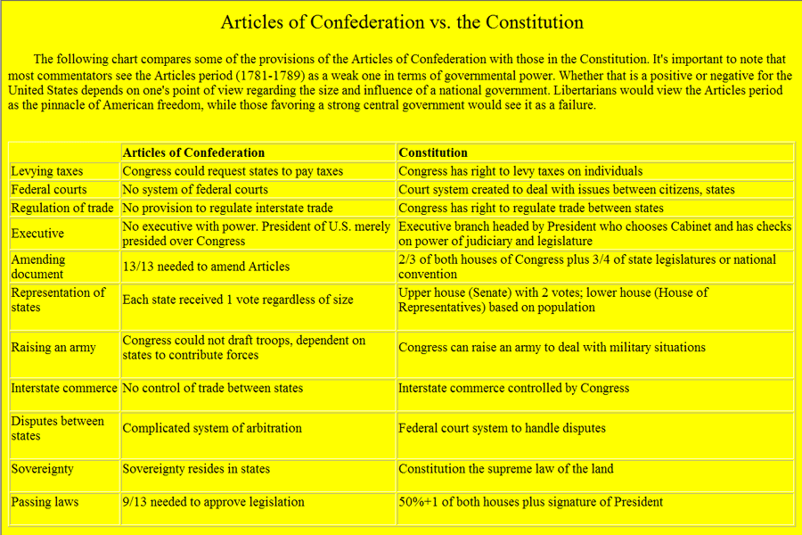
State citizen sovereignty vs. public municipal & private corporation bylaws
"Americans are so enamored of equality that they would rather be equal in slavery than unequal in freedom."
Alexis de Tocqueville
State Citizens, most especially the natural born are sovereign and free agents.
All the highest fundamental laws of the land protect American state Citizens from being taken without their free choice and/or in a business contract where there is a personal offer, acceptance, passing of value done without coercion or deception.
Employees of a private or public corporation are bound by employment agreements.
State Citizens not employed with a public corporation are not bound to comply to corporation bylaws.
Man made constitutions are limits upon government NOT the state Citizens, Citizens are unlimited.
Man made constitutions created private and public corporations not man. Private and public corporations and their cereal bodies are the children of the constitutions. The rightful state Citizen is a child of God NOT the child of these state charters.
These artificial man made public and private organizations have no power or jurisdiction over an American state Citizen who qualifies as a natural born or is a rightful naturalized Citizen.
The American Articles of Confederation required unanimous approval to amend or create charters and the Articles of Confederation is still alive.
The U.S. Constitution never received unanimous approval. Only 9 of the 13 colonies approved and some of them were exploited.
Many if not all of the state constitutions are not true and honest charters of a free and limited Republic, they are conditions of enslavement.

Slide 14
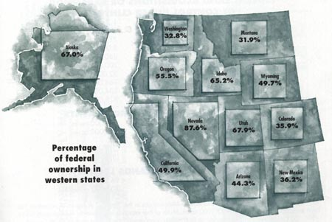
Planning your life away – one Stepford town after another
“No one can take anything from anyone without their express personal permission because the minute this happens, everyone else is given a better reason to take your property than you have to keep it.”
FreedomForAllSeasons
The true sprawl is the growing nodes of municipal and planning associations all over America, i.e. local city, county, state, national to global. Public planners and their councils of cohorts have swallowed a poison which makes them believe they have magic powers and insight regarding our sovereign and free future.
Planners believe they can plan every facet of:
  our life,
  property,
  what we each of us considers right and wrong,
  the density of the community we live in
  the appropriate designation of any land and air around our allodial land rights,
  what type of land is more appropriate for each of us to go onto or stay off of,
  the percentage of open space and agriculture space we may live on,
  crops the sovereign Citizen may grow or not,
  when you can burn your slash,
  the size of your toilet,
  the type of light bulb you can use as well as the appropriate license,
  permit and fees you will pay for all of the above,
  All while they trespass all over your property and birthrights and have no professional education in the area of their taking.
All these takings are being done without a vote or true understanding of the taking by the poor home owners. Most if not all of the state Citizens will not have a clue what is really going on even if they were told because they at the most listen only to mainstream media. These are back room deals between the benefiting municipal corporations and the non government corporations like Hancock Timber.
See how much land the federal government holds in the western states (above graph) and then add land taken by the states and their "constitutional" children (the county and city municipal corporations). There is no need nor fundamental laws of the land to use force upon the individual property owners and business owners to take land or anything when America is so rich and bountiful in resources and corporate revenue.

Slide 15
Someone else always has a better use of your property/wages than you do
“Watchfulness is the path to immortality, and thoughtlessness the path to death. The watchful do not die, but the thoughtless are already like the dead.”
The Dhammapada
Here is the dirty little secret the municipal and the corporations never mention. Constitutions are corporate bylaws written by the corporations and their liewyers and their banksters which originally gave birth to their mutant megalomania municipal dictatorships. This is the unspoken death knell to American freedom and liberty. Disembowel the municipal monarchies and transform them into public coops based on free choice and American spirit and prosperity will soar once again.
Property owners are undergoing tidal waves of property taking for municipal and NGO profiteering. Government land is largely taken out of production and becomes a burden upon the tax payers. Land grabs are power grabs to centralize and lock out local communities sovereignty and free choice.
Public and private internationally connected corporations are colluding and circling their wagons using extortion upon the small time property holders for the benefit of growing the global to local monolith strangle hold on American sovereignty.
One third of the state Citizens trust the public sector more than the private sector, one third are profiting from this delusion and the last third to one half trust the private sector more than the public sector. The truth is that a free and sovereign state Citizen should never trust either the private or public sector because they will both steal you blind while they convince you it is for your best good. Collusion is a specialty of politicians, liewyers and non government organizations.
Someone else always has a better use of your private property than you do, especially if they can put a gun to your head and force you to pay for it. Private property is a sanctuary for the family not a set aside funding source to buy developmental rights of the forest next door.
American natural born state Citizens have been overrun by a perverted mind game by liewyers, politicians and their benefiting NGO (non government organizations) all of which are profiting from the taking of our land in back room deals. Acquiring assets with the use of force, usury and collusion against the will of the sovereign and free individual state Citizen goes against the fundamental laws of our land, LONANG, the Declaration of Independence and the spirit and success of the first American Revolution.

Slide 16
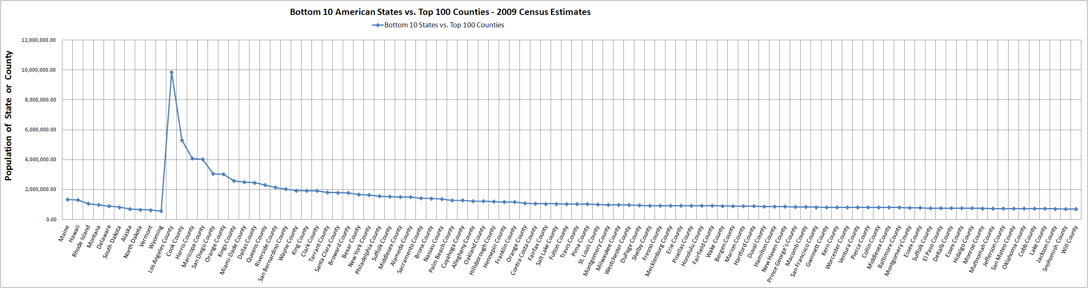
Hundreds of county municipal corporations increasingly larger than many states
“Cut down the whole forest of desire, not just one tree only.”
The Dhammapada
This problem is easy to fix. We must have individual free choice. We must reconstitute all the municipal corporations, incorporated and unincorporated into free choice cooperatives mandated to survive on a small single digit tax on state corporations. No taxes upon any family or individual property owner or small business is allowed for any reason. THERE IS NO NEED FOR MANDATORY INDIVIDUAL TAXES ON WAGES OR PRIVATE PROPERTY. THIS IS CLEARLY DEFINED AS STEALING BY THE HIGHER FUNDAMENTAL LAWS OF THE LAND.
This graph should tell you the whole story at a glance. Power corrupts absolutely and absolute power corrupts absolutely. This is what the globalist are going far, i.e. through the back door via the network of municipal corporations who are the equivalent of rogue governments operated by a few "elected" party hacks which are colluding with their favorite NGO's to expand their empires at the expense of all the property owners.
In short there are 112 counties greater than the smallest state and hundreds more equal to and slightly less than the smaller states.
The municipals are run by a handful of people who believe they have divine rights to all private and public property and NO THEY DO NOT. There can be only one sovereign in a free nation and that is the rightful state Citizen.
What is going on? The municipal dynasty is quickly devouring surrounding land, herding the masses into their Venus fly traps, parking out the rural areas and entering into national and international commercial, financial, entertainment, transportation, gambling, liquor deals all without any return on investment. Why would they do that? Because the political parties, the Bar Association, the public unions, the banksters and the benefiting NGO's are making a killing, killing the property owners faster than they can get out of Dodge. All while "Dodge" is replicating itself so fast there are no safe havens to run too.
Notice county municipals are calling their codes “legislation”. They have bestowed themselves over the sovereign Citizen by replicating the nature of the top down power structure of a global to local monarchy.

Slide 17
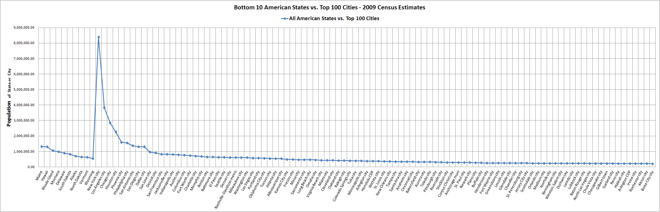
Hundreds of city municipal corporations increasingly larger than many states
“Greed is the basic cause of misery. If you extinguish greed, you are clean and free wherever you are. The mountains, rivers and earth do not block the light of your eyes.”
She-Hsien
Once you remove free choice from the equation of freedom and liberty in a true and honest limited Republic, the self bestowing nature of a municipal monarchy becomes a monopoly of force and like cancer cells aggressively replicates its takings.
Click on chart to link to full view of all charts and data
This chart is extracted from the above Excel series and shows how the top 100 cities compare to the bottom 10 states. There are hundreds more that are at and less than the bottom 10 states. This empire of municipal monopolies and monarchies is built on the blood, sweat and literal tears of millions of property owners like myself. This is not necessary and horribly regressive. This is arsenic and lace wrapped up in a feudal opiate which drugs those within its web to death. The spider gets fatter and the victims are strangled to death in its web.
Even The Boeing Company got sick of dealing with this mentality and out-sourced itself out of the USA Inc. and WA Inc. over decades along with every other corporation. Corporations with international customers are especially adept at picking up their jobs and leaving. Municipal Monopoly Monarchy mentality is forcing the private sector to cut basic future benefits of its employees because it cannot pay the government many times over as well as its employees and its shareholders at the same time and grow. The sovereign state Citizens are not so adept at pulling their roots and leaving. However, I see more of my retired friends also leaving and going to Ecuador and Panama or other location in the states where basic living costs and taxes are relatively lower.

Slide 18
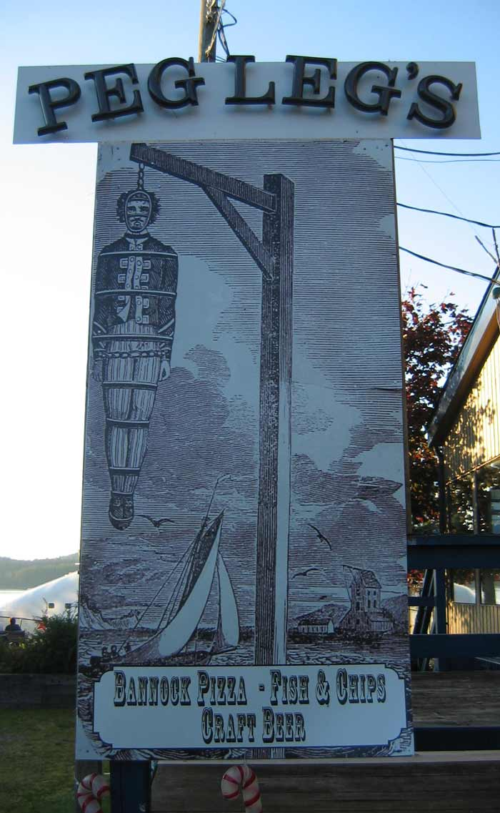
Municipalities are mutated mad children of a Constitutional democracy
Allie: "Tell me Mr. Cole How long have you been killing people for a living"? Virgil: " I don't kill people for a living, I enforce the law." Appaloosa, An American Classic 4, Shawn Edward, FOX-TV
City and county municipal corporations were created by the state constitutions which fall under the U.S. Constitution which falls under the Articles of Confederation, LONANG, the Declaration of Independence and the spirit and success of the first American Revolution. The Articles of Confederation give no power of taxation to the states. Corporations may be taxed yes, the natural born rightful state Citizen absolutely not. They cannot tax, regulate, charge usury or act as a proxy to buy anything including any form of land for a rightful state Citizen “safety” or recreation otherwise the sovereign and free state Citizen would be quickly enslaved by such “better use of your private property and wages. It is that simple. It is common sense back up by LONANG, clear warnings to King George II in the American Declaration of Independence and the action, spirit and success of the first American Revolution.
Councils and a few hundred so called "representatives" or "senators" or civic "administrators" cannot overlay what American clearly stands against as laid in the Laws of Nature and Natures God, the Declaration of Independence and the spirit and success of the first American Revolution. True and honest limited free Republics cannot concoct a "majority" vote for a better use of your property and labor. There are no exceptions to what is clearly the intent of the Laws of Nature and Natures God, the warnings written to King George III in the Declaration of Independence and the resulting action and success of the first American Revolution.
If a few politicians and lawyers with the help of their local NGO's could grow their fiefdoms by political decisions of a few people on a utility infrastructure (sewer & power) with a simple majority vote, the fiefdoms would grow and the Citizens would loose everything and they have.
Once individual free choice is breached then a true and honest Republic does not fully develop into an independent state.
Usury, regulations and direct and indirect taxing combined with the act of “planning” quickly grow into death by a thousand lashes upon the 70 some unalienable rights of the rightful state Citizen. No public servant can master their urge for power.
The municipalities are being manipulated by the globalist to effect an end run of the American state Citizen sovereignty and freedom.

Slide 19
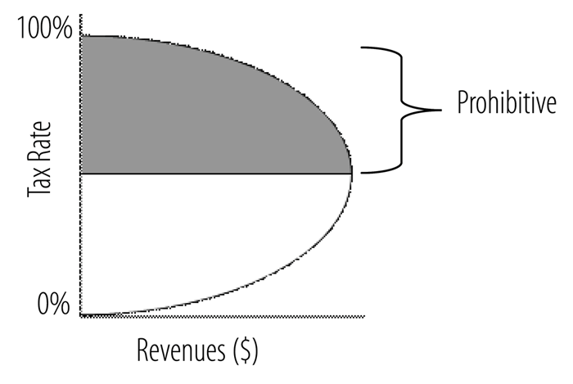
The laffer curve
Any tax upon rightful state sovereign and free Citizen is a regressive tax
Points On This Curve To Consider (cont.):
When a municipal or a state “purchases” land or land rights they do so by placing a gun to the head of the state Citizens or the private corporations. There is also land trading going on between private and public corporations which is relative better way to gain land however the end result of tying up local Citizenry with unending maintenance cost and regulatory nightmares is of rightful grave concern.
While public municipalities and their applicable state show positive net worth on their Consolidated Annual Financial Reports (CAFR), there is really no value in the true and honest sense, because their revenue and assets are all derived from extortion, usury, regulatory compliance by force and tax taking by force.
This removes any return on investment offered in an honest private corporation.
And the concept of tax is far worse than this. The “business enterprises the municipal or state enter into are largely operated at a loss which is also transferred onto the sovereign Citizen by force.
A public municipal corporation is genetically flawed because it is designed to be a predatory political animal, it can only take vs. provide true and honest services and dividends like say a public coop.
If taxes provide no value and are in fact regressive why are they used, there are several main reasons?
Reason 1: Control of the masses is a strong reason because most of the Citizenry have been brain washed to believe there are no other alternatives to provide them the security of a limited infrastructure.
Reason 2: Taxing labor and property allows the corporations to transfer 99% of their tax responsibility onto the apathetic public.
Reason 3: The public are more easily manipulated and relatively financially weak compared to the private and public corporations.
Reason 4: No one is allowed to exist outside of the public and private corporate sub-divisions.
Reason 5: The states are the Mother of the private and public corporations and the state Citizen is considered their employee by default whether you work for them or not.
Reason 6: This vial network does not tolerate competition or alternative forms of freedom, i.e. look at what is in common in the system and what does not exist, i.e. free communities.
Points On this Curve To Consider
Click on the graph above to read the obvious.
President Coolidge and the Laffer Curve
All taxes are regressive above 0% and increasingly more destructive after 50%.
This chart is a bit deceptive because it gives the appearance that a tax is acceptable at or below 50%, this is completely false.
All state and their municipal corporations are monopolies operated by force which provide NO RETURN ON INVESTMENT to the sovereign investors.
This would never be allowed in a private corporation and the private sector.

Slide 20
Look at The ways things are not – or I don’t want no stinken government public services – leave me alone
Look at what is NOT and see what has been taken:
All American municipals incorporated and unincorporated are organized basically the same and extort the community property owners and smaller businesses for revenue vs. freely paying your bill for only those services you use.
There is no experimentation with different forms of free communities and total oppression of such.
If any state or county or city tries to leave the system (secede) they are killed or those being left with the short stick refuse the others who wish to get out of the extortion racket..20
There is only 30 days different among all 50 states in their tax free day, i.e. there is relative little difference in the total tax taking.
While the formulas of taxing are somewhat different in each state and its municipal corporation constitutional children, the variables are finite and very similar.
The state and their constitutional municipal children represent centralization of power and are largely nodes reflecting their applicable state, national and global power structure, i.e. what the dictators sees, the other dictators do.
There are no communities or states which are completely free and true and honest limited republics where the Citizens demand no taxes, no regulations and no usury upon the rightful natural born and naturalized.
Why is everything the same?
Politicians are challenged in science, engineering, math, finance, et al and this is the very subjects they are stealing from the small property and business owners every day.
However they are very skilled and trained by our best public academic institutions in political “unscience” to learn how to easily write a code to seemingly legitimize what they want to steal from the property owners and apathetic public.
There are millions of poor people, retired people, elderly people, people with no children which cannot afford property taxes let alone use any of these glamour land takings or need to be extorted for anything including the corrupted public school system.
There are thousands of communities which would love to reconstituted themselves to better serve this growing group of freedom seeking public who say “I don’t need no stinken government public services”. And if they do they can more easily start their own volunteer or private cooperatives.

Slide 21
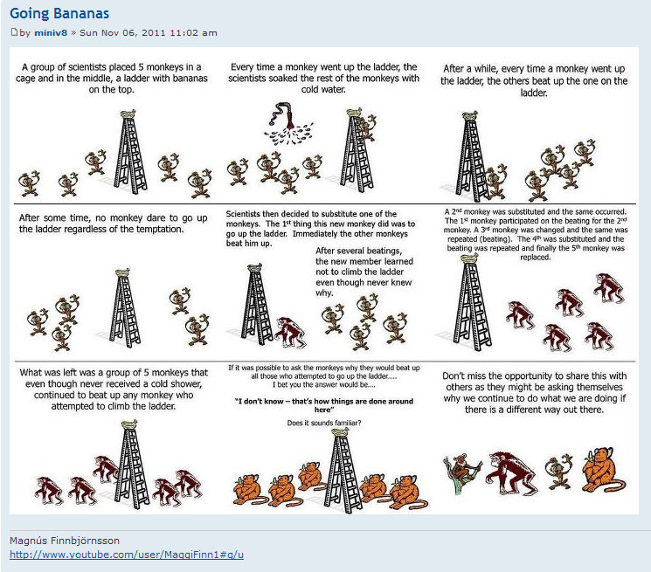
The nature of natural – Little dictators COPY little dictators
“The thing about Zen is that it pushes contradictions to their ultimate limit where one has to choose between madness and innocence.”
Thomas Merton
A true and honest free limited Republic does not imprison its Citizens or its resources based on politically contrived “public policy”.
Good and bad intent upon our land and water become blurred by the use of force and deception.
So called public policy do not restore nature, they ultimately destroy nature and the natural born Citizens.
The end intent of “public policy” does not justify the means.

Slide 22

The nature of natural – forcing property owners to pay to park.. …
“Life is a maze in which we take the wrong turn before we have learned to walk.”
Cyril Connolly
Political manipulation of nature kills creativity and assures failure due to collateral downstream problems beyond human comprehension impacting the generations proceeding.
Many false beliefs which have taken on a life of their own can no longer be supported in the mass consciousness.
The nature of these mass takings of property are debased on a false structure of political, “scientific”, financial and monetary negative rewards which have long run its course.
Elite groups of very passionate people have created their own reality through their own belief system and successfully projected it globally to locally like the popcorn effect.
The victims of these groups have a very different view supported by real science reality who cannot be obligated or forced to comply in a true and honest limited free Republic.
“Reality” is manipulated through various lens of perceptions, e.g. politics, religion, science, law, etc.
Manipulated data including holding back the big picture or creating a biased big picture through dogma boils down to intolerance for others unalienable rights and rightful credible dissenting “science.
Intolerance, fear and highly judgmental agendas are hallmarks of blind belief systems.
So called buffers, sensitive areas ordinances, critical area ordinances, Shoreline Management Acts, Growth Management Acts are environmental and social feasibility studies AT BEST which should never have been allowed into real life conditions.
True and honest limited free Republics never force property owners to do anything they do not directly contract and agree to do. Municipal sewer and water utility coops never take anyone’s property:
So they can look more green
So urban muni corporations CAFR’s look good
So they fit into the ICLEI global community
so they can borrow more
so they can tax more
so they can park out more land
So more local property owners have to sell and get out of this God forsaken county

Slide 23
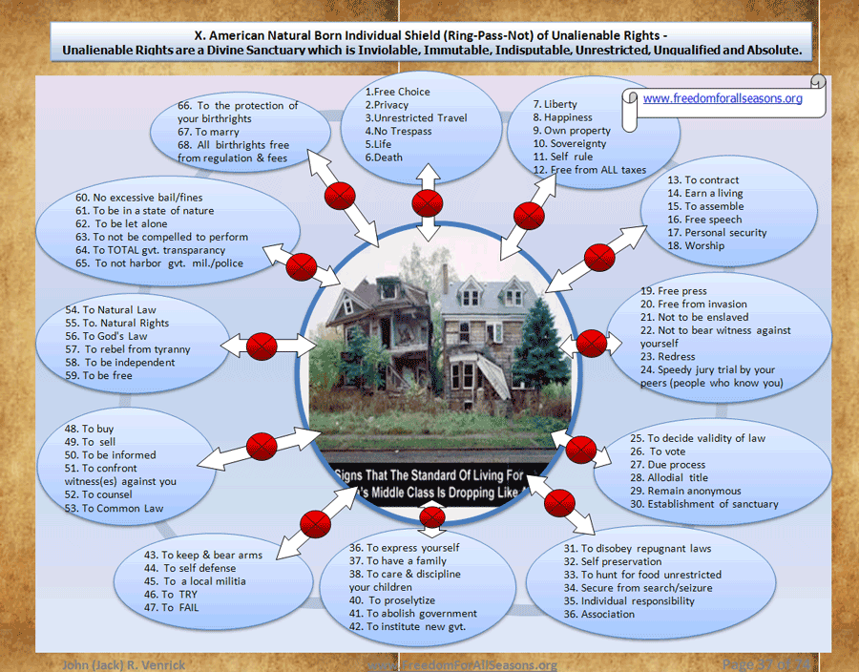
Home Owners Buffered out of their sacred sanctuary (boss)

Slide 24
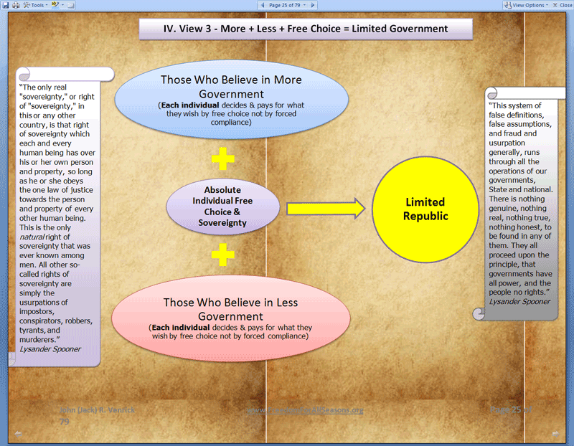
The Dialectic political box – how American sovereign & free citizens imprison themselves & how to get out
Americans have been programmed to believe it is acceptable for “majority” political decisions to force a sovereign Citizen to comply. This is a classic Hegelian Dialectic, i.e. “problem, reaction, solution” created by the global to local planning agendas.
What the politicians and their over controllers never tell you is they cannot dictate away individual free choice especially relating to their birthrights or unalienable rights by “majority or minority votes” in a true and honest limited free Republic.
State sovereign Citizens are free to live under the rules they freely choose, however they are not free to force others to comply and fund their political , religious, environmental or recreational ideologies.
Discerning higher truths over lower political manipulated de facto lies is a critical skill for any free sovereign Citizen. Politics is a religion developed to broker away the higher truths to the highest bidder. The politicians, corporations and their lawyers created the current system not the sovereign state Citizens. The current system is a manipulated dynasty of no choices to keep the global to local regime in power.
Political party ideology creates a fight or flight frenzy, i.e. shark feeding.
The state and the church invented the municipal monarchy and the symptoms are enslavement, tyranny, hate and the break down of society, freedom and liberty over generations.
Political parties mutate normal human social behavior using inhuman eusocial planning strategies for ant & bee colonies by rat packing humans into municipal fiefdoms then brokering out their allodial private and public land for political favors of land use.
Political parties and their chains of municipal and BAR associations create false choices using dialectic theory to distract Citizenry from core takings of Citizen private and public property.
Free societies embrace and encourage individual differences and free choice versus "global to local" centralization of power which eliminates individual free choices which is a very intentional taking.
Municipal corporations engender hate mongering through political, legal, property taking and financial false deviousness vs. solving core problems. This is the nature of force.
Political party systems are a self feeding paradigm where positive self correcting change is designed out and negative change is designed in, e.g. someone always has a better use of your property than yourself when others are given a chance to decide.
The solution is individual free choice and aggressive experimentation with different free communities not over lording centralization.
http://freedomforallseasons.org/FreedomFromMunicipalCorporations.html
“People must get into some trouble before they do much thinking. As someone put it:”Man seems to jump from a hitch to a hunch. ” If man tries out enough things, maybe he’ll learn something.”
John Dewey

Slide 25
Washington state is dumping parks while king county municipal corporation is parking out more private land on the backs of local property owners
Other Park Related Property Owner Horror Stories
WA State Is Dumping Its Park System, Keeping The Taxing Funding AND Running
2013-01-29 Parks, Property Rights, And The Possibilities Of The Private Law
2013-01-27 Courts throw out gun ban in city parks throughout state - The Western Front News
2012-07-11 Request For Info re. Private Property Selling Problems Around Parks, National Monuments, Conservation Areas
2012-05-12 Re. Global to National to Local Park Takings
2012-04-05 National Monument issue - San Juan Island County Council voted 6 to 0 To Include BLM Lands
2012-03-20 Write a Letter To Stop Land Transfers From Local To Global
Tom DeWeese on National Heritage Areas, UN Heritage Areas and "Hallowed Ground,
Municipal Research and Service Center Washington - Park Facilities
How Parks Become Like a Cancer
2011-11-01 The Post-Postal Society - {If We Do Not Need Public Postal Service We Definitely Do Not Need Public Parks}
2011-11-01 Tort Law - Sports Law
2011-11-01 San Rafael neighbors continue to debate merits of baseball in their town
2011-11-01 Baseball Sound Systems Acoustics
2011-10-17 PARKS, PROPERTY RIGHTS, AND THE POSSIBILITIES OF THE PRIVATE LAW
2011-10-14 Bike park/trail impacts property values
2011-06-25 Facelift or Theft
2011-05-25 The Nickolis and Charvilles have been engaged in years of litigation against Defendants over MetroParks’ attempt to establish a public bicycle and “leisure” path across their property on the former Milan Canal Corridor (the “Canal Corridor”).
2010-11-01 Dr. Edwin Vieira, Jr. on the Failure of the Public Sector, the Coming Military Crackdown
2010-10-31 Late Post An Urgent Call For Private Property Taking Process Reform
2008-08-27 King County Washington Forecloses on 11 Enumclaw Rural Property Owners Access Road Including Venrick's
Cooperation vs. Coordination
Adverse Possession Law
Greenway_lawsuit
10-30-09 National Park Service Bad Neighbor
80 Years of National Park Service Abuse
John James McFarland v. U.S. Park Service
12-5-08 National Park Gun Ban partially overturned
“Beyond 2013 – A Transformation Strategy
In 2003, the Washington State Parks and Recreation Commission adopted Centennial 2013, a vision for the future of State Parks and a plan to carry it out. For the past decade, State Parks has been working with the public and park supporters to upgrade and improve state parks all across Washington.
As Washington State Parks enters its second century of service in 2013, a new plan must be developed to meet public needs and desires, and to continue State Parks' legacy of stewardship for future generations.
A new strategic planning process is now under way, involving recreation, heritage and conservation groups, park neighbors and supporters, legislators and other governments. We are exploring choices and setting direction for the next five years and beyond. We especially want those who love state parks to be involved in the process. Information gained through the process will be used to develop the transformation strategy intended to succeed the Centennial 2013 Plan.” http://www.parks.wa.gov/Beyond2013/
THE MEANING OF THE ABOVE GREEN SYRUP OF IPECAC IS:
WA State Inc. is not making enough revenue, a.k.a. taxes, on our park system so they are going to sell it off to the highest bidder AND continue to tax and take more and do less. This is what WA State Inc. and its legions of Muni. Corporations are designed to do best, tax, take and make it look like chocolate cake while transferring the sovereignty and ownership of your private and public property and your local businesses out of state and out of country. All while they increase their revenue and net worth.
“Heritage” is a key word taking for UN and global groups,
“other governments” are foreign governments,
“conservation groups” love your land so much they will do anything to take it from you. Here is a short list of 40 some: http://usparks.about.com/blparklands-oz.htm .
The “transformation strategy” means the WA State Sovereign Citizens will own and control less of his or her public land and pay more big time.
FreedomForAllSeasons

Slide 26
King County Municipal Corporation - 14th Largest county in America is helping Vashon island take more private property to make it’s 23 park taking for only 10,000 people
1. King County Municipal Corporation taking 43,000 acres –
of developmental rights of the White River Forest in King County Municipal Corporation Washington state as large as the country of Turkey plus more property taxes without debate or long term costs impact or approval from the local private property owners. Then it appears the County Council are planning to give stolen private property taxes to a global holding corporation to make king county municipal corporation and Hancock Timber Corporation larger.
2. Then King County Municipal Corporation takes more private property on Vashon Island Washington for the Vashon Parks Department number 23. Twenty Two parks are just not enough for the 10,000 some people living on Vashon Island in King County.
3. Then King County Municipal Corporation spends more wasted tax taking along little Boise Creek in addition to the $5+ million to reroute a little creek near White River bridge between Enumclaw and Buckley Washington and
4. Then King County Municipal Corporation shuts down local home owners and farm businesses who try to survive against all the tax taking.

Slide 27
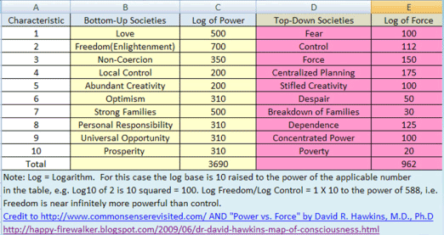
Force never works – it creates more problems than its worth – part 1 of 3 we can have what we need without stealing private property
“For Whom Do The Park Bells Toll, They Toll For Thee.”
City of Seattle privatized the City Aquarium and the Zoo because they were increasingly forcing operational costs onto the local property owners. Now the private owners/investors are free to make a profit and provide a viable service to the Seattle visiting public not on the backs of local property owners.
The state of Washington is offloading its Park System
Public owned park systems poison the community private and public property because once land can be taken for “free” there are never enough parks to satisfy everyone as long as their land is not taken.
If this slide seems counterintuitive to what you “know” about parks please refer to the site page link below for examples. Note one case in particular of the Rosser family on Vashon Island in King County. Vashon Park Division has 22 some Parks but the School Dist. , Park Dept. and King County still must walk all over one of best and dearest families I have long known over 47 years.
  http://www.freedomforallseasons.org/FreedomFromParkTakings.asp
A municipal corporation is debased on the ideology of a monopoly and a monarchy while using tyranny and force in a free limited republic which can be easily privatized and/or reconstituted into a coop giving everyone free choice to make the right decisions for themselves and their family not on the backs of others who do not want anything for anyone and most especially when stealing property from A to give to B all done by B and C.

Slide 28
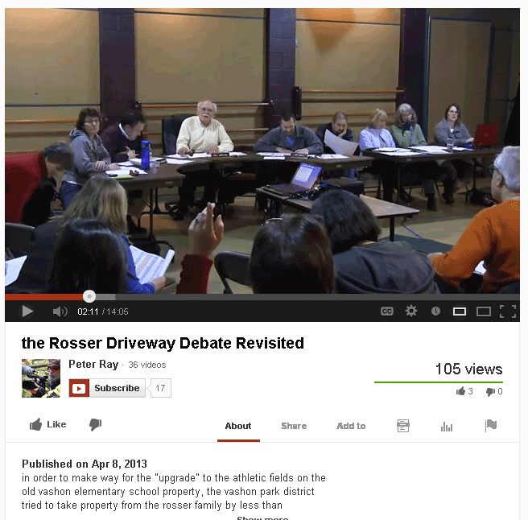
Force never works – it creates more problems than its worth – part 2 of 3 – The Rosser Property Taking
FreedomForAllSeasons thoughts after watching this video:
  Notice how the council is relatively silent about the outcry regarding the deed/survey Vashon Park Dept. (VPD). Notice how the councilmember gavels down the protest that the deed is wrong then brags the Parks Dept. spent $20K of the local property owners money for the survey and deed changes. The deed/survey appears to have been cooked to be right then wrong then right to accommodate the taking schedule, if I understand the evidence presented in the video.
  This amounts to over $2 extorted from every Vashon Island property owner so they could hack out more of Rosser’s property where the original school land was more than enough for a park and this land was originally donated to the community by Mrs. Rosser’s family which seems to be ignored.
  Notice no public explanation of why the deed/survey was wrong is allowed and gaveled down. They do not want this on the record or before the public.
  Notice the arrogance of the leading council member speaking whereby he believes they have some position of “divine rights of kings” and what they decide is irrefutable and not debatable. In a true and honest free limited Republic representatives of the sovereign and free Citizens have no power or jurisdiction over the allodial rights of local private property owners. The only role of a public council is to provide a public forum where the council can ONLY be advisory and never adversarial.
  When public meetings are held the takings are more often “saucered and blown” and the dirty deeds are done before the meeting. The “surveys and feasibility studies” are cooked and the public meeting is a mere ceremony of marketing designed to congratulate the thieves who have needlessly harassed the local property owners into bankruptcy.
  Link below for “everything” you want to know re. the dark side of public parks & how to bring them into the light of free choice - http://www.freedomforallseasons.org/FreedomFromParkTakings.asp
  Rails To Trails is the same profile of force and deception to take private property. –
  http://www.freedomforallseasons.org/FreedomFromRailsToTrailsTakings.asp
Vashon Island WA Park District (VPD) Meeting –
Click here to view this YouTube video where VPD denies the survey was changed more than once to accommodate the taking.
MUST SEE Rosser Vashon Island Park Department (VPD) Taking -http://www.youtube.com/watch?v=FtC03mySX4Q

Slide 29
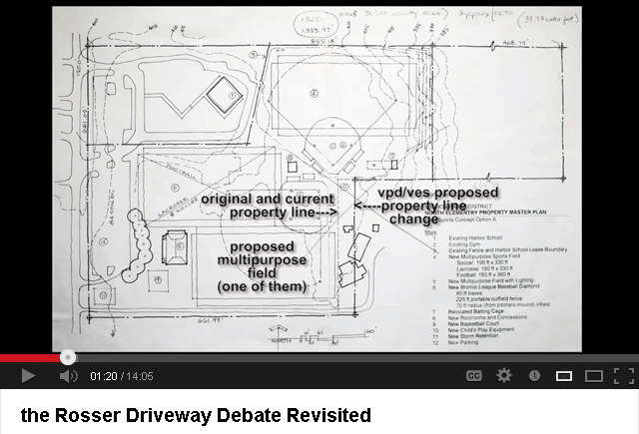
Force never works – it creates more problems than its worth – part 3 of 3 –
The rosser property taking
Isn’t it interesting that a community council of 8 people on an Island of some 10,000 people with 22 parks have no interest in the reasons why the survey/deed is not correct of a well known and old time family on Vashon Island for over 60 some years?
Communities are based on love NOT taking by force. Parks come from the heart of the land owners to the community by donation not from political graft.
Community parks are acts of giving not acts of taking. Local Citizens join together to build the park as a gift of their labor and material. This is why parks created by the state and its municipal corporations using taxes, usury, regulation and force are becoming problematic. This problem was not seen immediately in the past because it used to take generations before the surrounding property owners and those being forced to fund what they did not directly approve realized the dark side of parks. Taking private and public land on the backs of struggling property owners for even the apparent best of reasons like parks will ultimately fail because of the negative collateral damage upon all property owners forced to pay as well as the surrounding property owners.
This is a tuff lesson for every community as they awaken to their true divine rights. It takes years, even decades to go through these torturous takings through one level of court to the next and millions of dollars, often the property owners is bankrupted or their family or they may die during the proceedings. All of this can be avoided by respecting the property owners allodial rights and recognizing the power and the sovereignty lie in the individual rightful state Citizen NOT in the big egos of the little people serving public administrative functions. This is why power was never given to public servants because they will quickly centralize it and assimilate the community who have little time or resources to monitor every move these servants are making against their master.
Ownership of private property is a divine right, a birthright and an unalienable right. These rights are inviolable, immutable, indisputable, unrestricted, unqualified, unconditional and absolute. So called “eminent domain” is a feudal lie created by the kings and the church to justify each others turf taking.
Once one Citizen or one public servant comes up with a “better” reason to take someone else’s property more takings quickly follow. We must learn to think and observe of these takings upon groups of people over generations vs. the feel good and happy taking talk of the moment.
Some 10 acres which this Vashon Island park sets directly in front of the Rosser property. Originally it was a community school house and play ground not long ago. I used to play there when I was a much younger man. That property was owned and donated by Mrs. Rosser’s parents so their children & the children in the neighborhood could have a school close to where they live. The Vashon Island Park Department, Vashon School District, King County Municipal Corporation and all their lawyers , judges, survey crews, warrant servers and contractors they hired to encroach upon the Rosser property do not recognize this bit of history. They just want Park Number 23 to put into there coffers.

Slide 30
Dismantling municipalities
Politics is a manipulated religion. Here is another example - http://www.businessinsider.com/republican-budget-hypocrisy-2011-7
No one can vote these rights away. No natural born American may be licensed, taxed or coded for any reason at any time by anyone by force nor may any data be gathered by violating additional unalienable rights, e.g. the right to privacy. Citizens cannot be forced to do anything they do not individually contract to do.
American Citizens cannot be forced to contract through adhesion or coercion, i.e. force voids all contracts.
American natural born and the rightful naturalized never subordinated their sovereignty. In other words, there are no rightful reasons to comply to any forced takings of private or public property by any predatory municipal corporation or state cereal agency whether government or public or private corporation.
Here is a must read site reflecting above high truths.
  http://www.sodahead.com/united-states/the-right-of-travel-vs-drivers-license-revenue-ploy/question-1475649/
"What freedom is not. Many people attempt to destroy the word freedom, attempt to make thoughts of freedom unthinkable, by making the word meaningless, by applying it to anything and everything. P. J. O'Rourke dismisses such evasive weasel words: Freedom is not empowerment. Empowerment is what the Serbs have in Bosnia. Anybody can grab a gun and be empowered. It's not entitlement. An entitlement is what people on welfare get, and how free are they? It's not an endlessly expanding list of rights — the "right” to education, the "right" to health care, the "right" to food and housing. That's not freedom, that's dependency. Those aren't rights, those are the rations of slavery — hay and a barn for human cattle. “ Credit to http://jim.com/freedom.htm

Slide 31
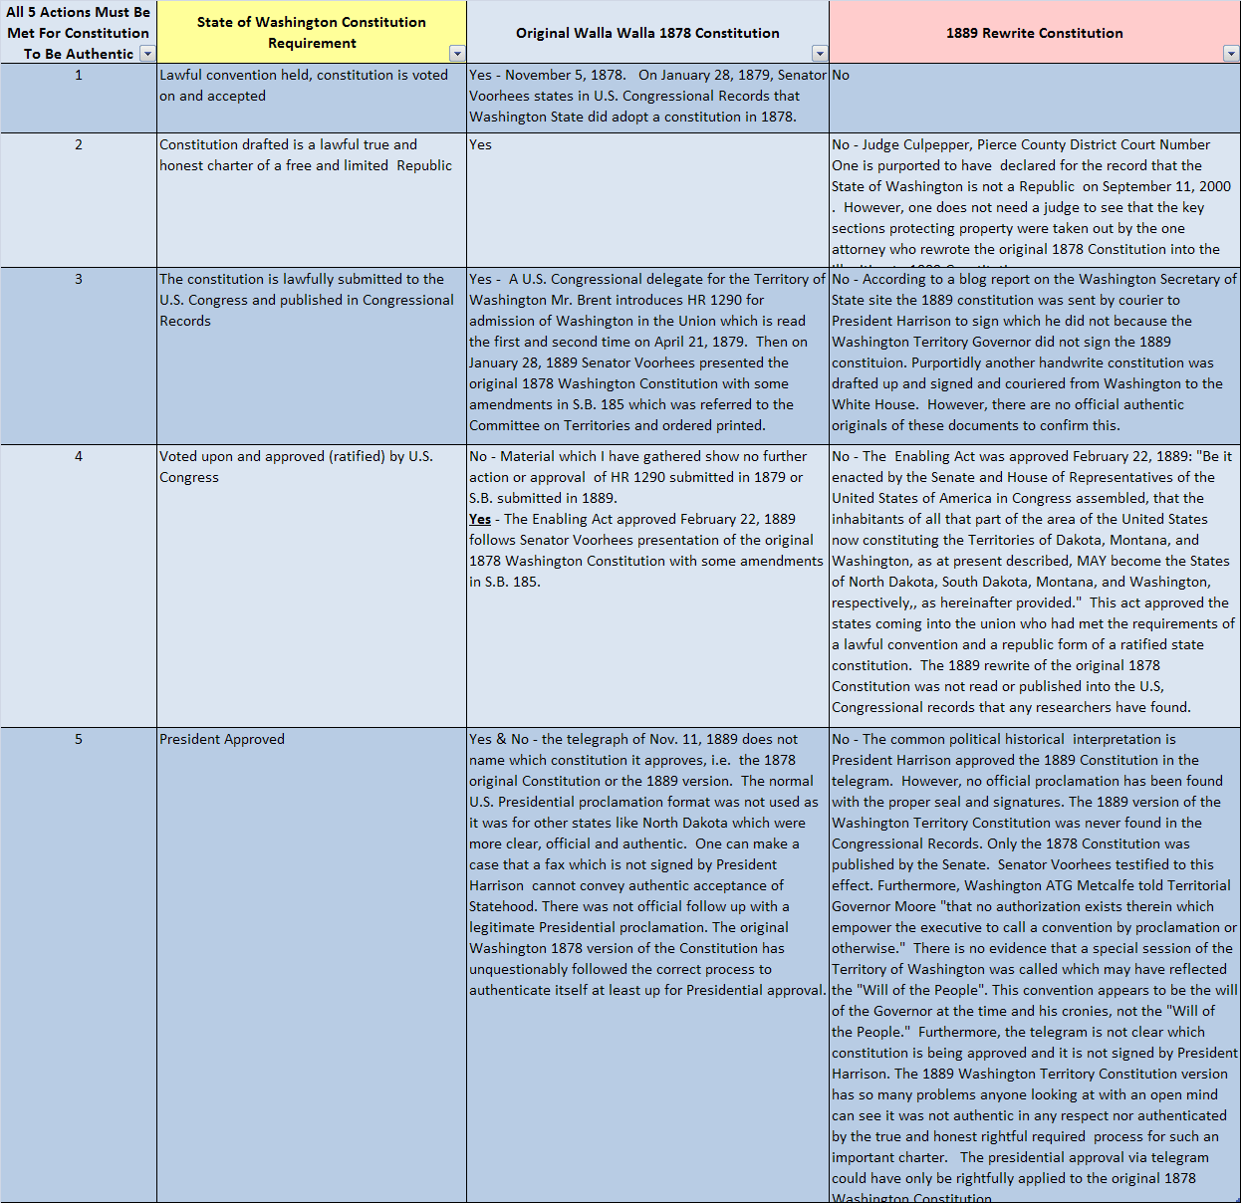
Washington state constitutions – the constitution that never was - Part 1 of 2
Click on table to link to full view.

Slide 32
Washington state constitutions – the constitution that never was – part 2 of 2
What the prior table and snapshot to the right reveals:
The current 1889 Washington State Constitution is not authentic.
The original 1878 state Constitution is authentic by default because it met the 5 actions required.
Please check out all the research provided on this site and make your own decision, this is not rocket science, it is political deception at its best.
Most clear is the original 1878 constitution was far more clear in protecting our birthrights and unalienable rights such as property rights. The 1889 rewrite was not protective of our property rights. Key protective clauses were stripped out by a “prominent attorney” at the time in the 1889 rewrite.
Plus the 1889 rewrite has been further revised some 100 times to further dilute the higher fundamental individual rights of LONANG, the Declaration of Independence and the spirit and success of the first American Revolution.
Explore further research and discover how state “constitutions are cooked and then used to cookie cut other state constitutions as they rolled from a territory into the “union”. - http://www.freedomforallseasons.org/FreedomFromTheStateofWashingtonCONstitutionThatNeverWas.asp
ABSTRACT OF THIS PAGE AND WEB SITE
The highest charters and actions of the land, e.g. the Laws of Nature and Nature's God, the Declaration of Independence and the American Revolution have been laundered into a vast hierarchy of illegitimate municipal corporations using corrupted constitutions written by "powerful" political and legal elite's, who were NOT given such authority nor jurisdiction by the common people.
"They exceeded their power by very far".
They did not draft true and honest limited & free constitutional republics. Closed door secret sessions with agendas framed up property taking articles by intentionally leaving out and/or scrubbing out, property protecting rights for which there was no authority or jurisdiction given by the people, or the highest charters and action of the nation.
The vast majority of the state natural born Citizenship have been duped.
The drafters and their "delegates" were "soiled“ with political agenda, historical ignorance plus self bestowed illegitimate power and uncontrollable greed.
FreedomForAllSeasons Research for 9 years and growing

Slide 33

One big taking after another - of your wages and private and public property – tell these usurpers of our property rights no white river forest development rights takings
”A Zen priest was jailed several times after getting caught stealing small items from his neighbors. “Please”, a friend begged him, “stop stealing. I will provide you with what your need.” “It’s not that,” the priest replied, “I steal so I can get back to the prisoners, and bring them the message about the Way”
Zen Story
King County Muni Corporation Hypnotizing the Sheeple While They Stealthy Steal Their Backyard Transferring the Assets Into Their Consolidated Annual Financial Reports.
TELL KING COUNTY MUNI CORP NO MORE PROPERTY TAXES and to GIVE BACK ALL OUR STOLEN PROPERTY AND WAGES.
The primary mission of a municipal corporation is to tax and take and expand their municipal corporation into a global to local franchise networking with globalist banksters, liewyers, and NGO’s to centralize all world private and public property and labor for dominance.
Municipal corporations are dressed up and marketed to appear to make the public “safe.” One third of the sheeple want this security because they live in the high density urban areas. One third are profiting from this eusocial paradigm and one third to one half constantly battle to get out.
To fully appreciate how once simple free choice basic community civic infrastructure for utilities have been expanded into state like powers check this site out - http://www.kingcounty.gov/council/legislation.aspx.
i.e. A voluntary free choice equivalent of a coop now considers it is the legislative branch , e.g. Home Rule .
In other words, this is no government at all, nor is it a provider of free choice basic utility services where you decide what you want or not. The global to local associations are constantly assimilating more of our private and public land and individual sovereignty and free choice. This group of utility sewer & utility providers has delusions of grandeur.
This photo was copied from the King County Municipal Corporation web site and considered in the public domain.

Slide 34
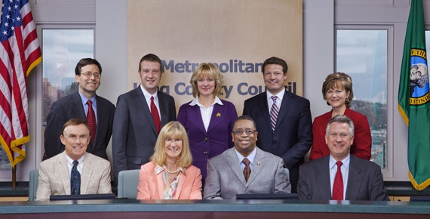
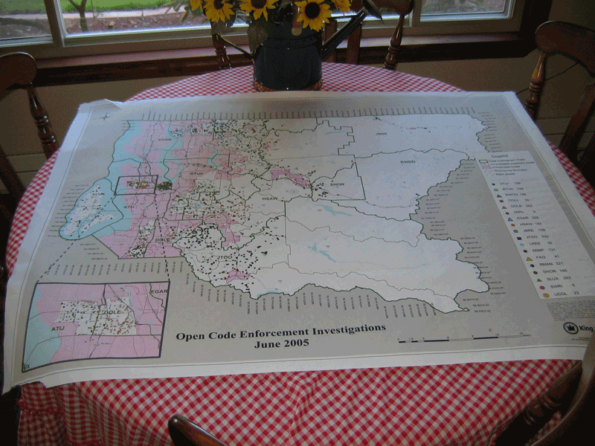
duped GOVERNMENT employees globalizing American local land and water for their parks
Tell these usurpers of property rights –
no White River Forest Takings
Rod Dembowski District 1, 206-296-1001
rod.dembowski@kingcounty.gov
Jane Hague Council Vice Chair, District 6,
206-296-1006 jane.hague@kingcounty.gov
Larry Gossett Council Chair, District 2,
206-296-1002 larry.gossett@kingcounty.gov
Pete von Reichbauer District 7, 206-296-1007
pete.vonreichbauer@kingcounty.gov
Kathy Lambert District 3, 206-296-1003
kathy.lambert@kingcounty.gov
Joe McDermott District 8, 206-296-1008
joe.mcdermott@kingcounty.gov
Larry Phillips District 4, 206-296-1004
larry.phillips@kingcounty.gov
Reagan Dunn District 9, 206-296-1009
reagan.dunn@kingcounty.gov
Julia Patterson District 5, 206-296-1005
julia.patterson@kingcounty.gov
Dow Constantine, County Exec.,
206-296-0194,
One World Government Ignorance
UN Agenda 21
King County Muni. Corp. Council Education Profile
(top to bottom left to right)
Ferguson – Political Science / Law
McDermott - Public Admin. /History/Law
Patterson – Society & Justice/English
Dunn – Undergraduate no subject mention/Law
Lambert – Teaching/BA no subject/AA no subject
von Reichbauer – No education mention
Hague – No education mention
Gossett – graduate UW no subject mention
Phillips – JD/Masters of Law
Dow Constantine - Politics/Law (Absent)
King County WA Muni Corp.
Property Takings Map
King County Municipal Corporation, constitutional child of WA Inc., Council members are forbidden by the American fundamental and founding laws of our land to assume this sovereign role which is exactly why this power is left strictly to the sovereign and free individual state natural born Citizen.
These employees only have authority over county employees. This group of political egos has been given no rightful authority or jurisdiction over any Citizens private property or family business. Municipal employees have no rightful power or authority than a common janitor, plumber or electrician. Mayors, councils and cereal agencies are merely utility providers, e.g. sewer.
The political parties and NGO’s behind this council front themselves with false masks by creating dialectics for power and profit. Voting different parties in and out of office has no effect to the game plan of the global to local agenda. The agenda is to take all forms of rightful individual sovereignty and replace it with global to local false flag political, banking and legal control to suffocate any form of sovereign State Citizen freedom and liberty to keep you “safe” while safely keeping them in power over your freedom and liberty.
The city and county municipal corporations are taking private property from the home owners with one hand thru property tax extortion while they tie up more private property in land development rights with the other hand.
To fully understand how easy it is to dupe government employees; (1) look at the make up of this county municipal corporation council. They have no technical education or skills to separate fact from fiction which is handed to them by their NGO & cereal agency stooges. Yet they are ruling on science and engineering policy they have no clue about and worst yet, they are strongly biased in outcome debased political agendas.
(2) More facts at these sites:
Freedom From Rural Cleansing BY Global To Local UN Agenda 21
Freedom From Critical Area Ordinances Myths
Current Property Battles -Taking Back Our Rights
Freedom To Own Property W/O TYRANNY - Embattled Owner Stories

Slide 35
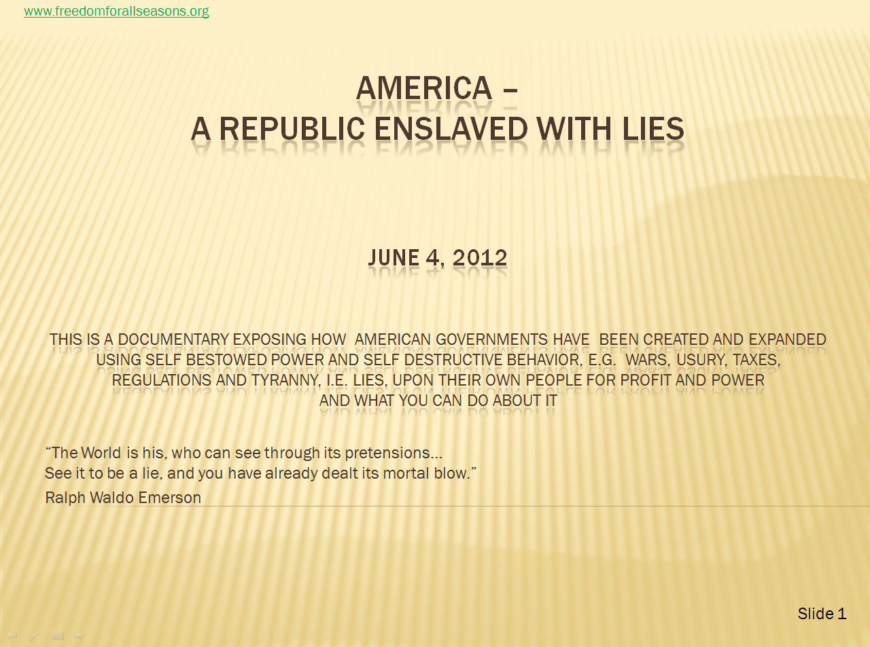
America – a republic enslaved with lies – a forthcoming research documentary
The following 7 slides are extracted from a 200 slide forthcoming PowerPoint presentation which has been in work for a shy year.
No direct or indirect tax taking is necessary or legitimate in a true and honest free limited Republic. How can this be, you may ask?
The following slides will give you a clue of the massive lies we believe in which are fed to us by the global to local state created municipal monopoly monarchy invented by sick minds which offer up torturous over controlling systems of fear based “problem – reaction – solution” which are ideological fly traps which have no place in a free limited republic.
After you digest this forthcoming documentary, your consciousness and eyes will become wide open expanding your belief system such that it will not limit you again, into the political cesspools of lies.

Slide 36
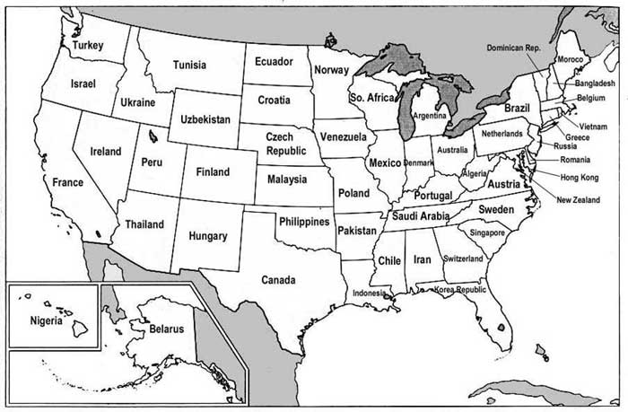
How states fund their lies – part 10 the big picture using countries with similar gdp
This is how the globalist and central banksters think of each American state.
Whatever state you are in, is equivalent to a world country in wealth. The international corporations and banksters invest their fortunes to take your labor and property using the NGO’s and states and their municipal corporations..
There are hundreds of counties larger and near equal to these states with similar GDP plus scores of cites.
The states and their constitutional mutant county and city municipal corporations were originally intended to be simple utility sharing of basic services by free to minimize such cost.
The original community utility function of sharing BASIC AND LIMITED infrastructure service reinvented themselves into a predatory local to global alliance USING AND REDEFINING FORCE.
This business model is a combination of a monarchy and a private corporation.
This is a self protecting, predatory and extremely aggressive mutation of the dark side of both models.
These pathological lying predatory monopolies would never be allowed in the private sector let alone in the public sector of a true and honest Free Choice Republic.
Before the state sovereign and free Citizen would tell his local community utility how many toilets and appliances he had in his house or shop and they would set him up. If the Citizen did not like the cost or the service he would go else where or drill a well, i.e. he had choices for basic services.
Now the servants believe they can ration and tax and license basic services. Freedom and liberty are upside down and backwards.

Slide 37
The property tax lies – silent slavery – part 1 of 7 the beginning of the lies
Property taxes go against the sovereignty of the American state Citizen.
Municipal corporations and states are NOT sovereign.
Property taxes go against 68 individual unalienable rights.
Property taxes go against the allodial rights conveyed to the state Citizens after the American Revolution as well as treaty acquisitions of land from England, Spain and France conveying allodial rights.
  http://www.freedomforallseasons.org/FreedomToOwnLandWithAllodialRights.dwt.asp
Property taxes go against the Laws of Nature and Nature’s God (LONANG)
Property taxes go against what the Declaration of Independence condemned.
Property taxes go against the spirit & success of the American Revolution I and the Bill of Rights.
Property taxes are not apportioned evenly assuming constitutions can be used to take birthrights, which they can’t.
Property tax taking cannot be legitimatized by the U.S. or state constitutions, because these are corporate bylaws limiting public and private corporations NOT giving them power over the state Citizens.
Property taxes are used to take more private property not protect it. Rosa Korie found this out and wrote a book about it and is on a speaking tour waking up fellow Americans - http://www.postsustainabilityinstitute.org/board-of-directors.html
“The {U.S} Constitution {and state constitutions} is not an instrument for the government to restrain the people, it is an instrument for the people to restrain the government.”
Patrick Henry

Slide 38
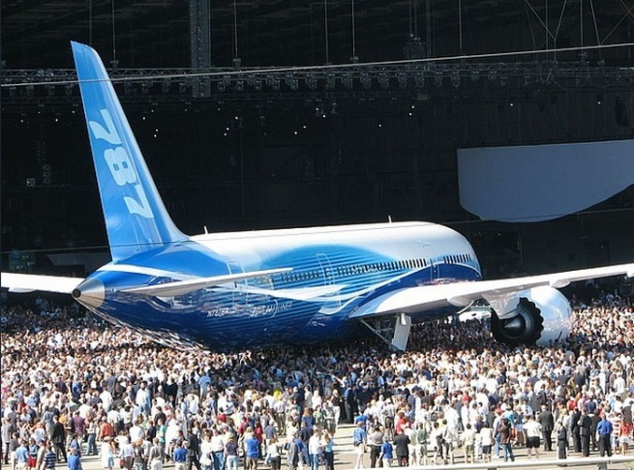
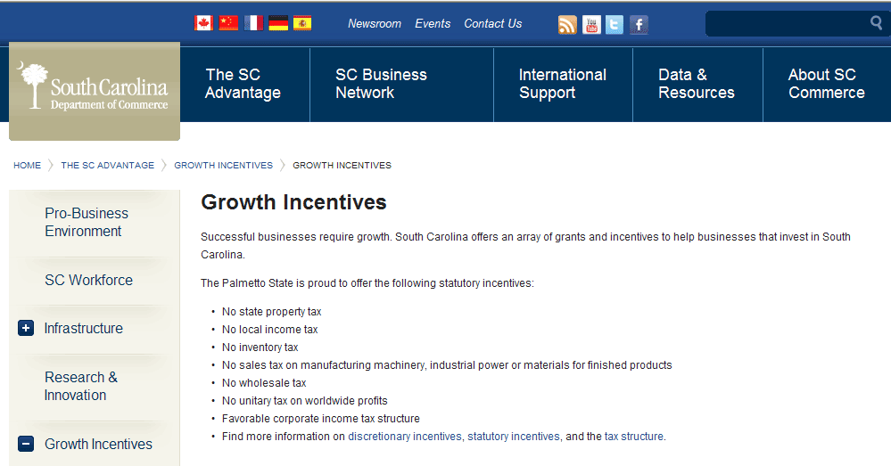
The property tax lies – part 2 0f 7
"To lay with one hand the power of the government on the property of the citizen, and with the other bestow it on favored individuals...is nonetheless robbery because it is done under the form of law and is called taxation.“
U.S. Supreme Court Loan Association v. Topeka (1874)
1) Three state high courts have ruled property taxes unconstitutional to their state constitution because they are not uniform, see Other News #11 following.
2) Uncertainties of the Income {some courts ruling income is property} Tax” by Larry Becraft, a 12 page report referencing 116 court cases ranging from states, federal circuit courts and supreme courts proving the hypocrisy of their conflicting rulings on all aspects of the growing unclear tax laws and codes including basic definitions of “property”, “income” and the “duty to file”.
3) “It is settled that when the law is vague or highly debatable, a defendant…actually or imputably…lacks the requisite intent to violate it.” United States v. Critzer, 498 F.2d 1162 (4th Cir. 1974)
Other News Against Property Tax Taking
Link here to view actions repealing property tax in America
Other States Joining Florida in revolt against rising property taxes
Pennsylvania Property Tax Assessments Unconstitutional
Property tax assessment law ruled unconstitutional by Oklahoma
Property Taxes & The Slide Of America Into Socialism
Property Taxes on the Rise Across America
Repeal of Property Tax Progress in Indiana
Repeal Property Taxes
Rights Come From God & Cannot Be Taken or Taxed – Privileges Come From Man & May Be - Learn How Traps are Set To Take Our Private Property.htm
The Final Solution to Property Tax - landpatents-allodial_title
Why Private Property Taxes Are Unconstitutional and Treasonous (Enhanced)
The Beginning of The Lie (Must Read History to Understand)
SOUTH CAROLINA - DISMANTLING ITS OPPRESSIVE TAXES, GUESS WHERE BOEING IS GOING………….
No Taxes in South Carolina Incentivizing Business Plus South Carolina is the next to the least taxing state -
Guess Where Boeing is Going

Slide 39
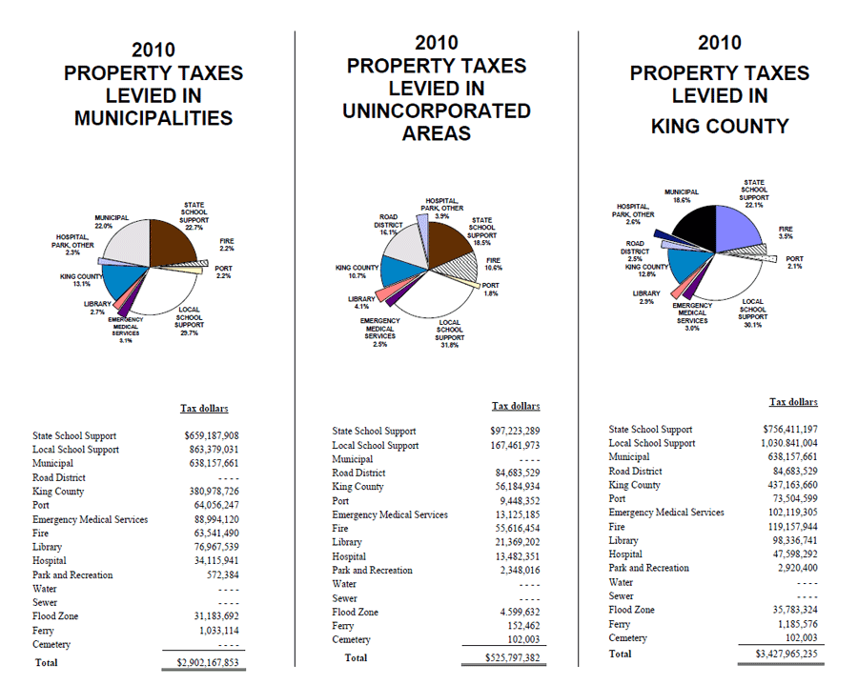
The property tax lies – part 3 0f 7 – backing the municipal losers in perpetuity
$3.428 Billion in Property Tax Extortion Racket upon property owners in King County Municipal Corporation which is a mutant constitutional child of the state of Washington That Never Was, i.e. it has no legitimate constitution of a true and honest free limited Republic and this is only one of 39 county municipal corporations in this state that never was.
King County Municipal Corporation has divided itself into 163 taxing cells to extort over $3.4 billion in property taxes from individuals, families, family businesses and corporations in the county, NEEDLESSLY.
The net assets of the Governmental and Business Type Activities are increasing 4% annually over the last 3 years (2008 -2010) and their revenue is increasing 0.7% annually.
Over the last 10 years of property tax taking, the state “assessed” value of King County WA has increased 82%, property tax rates have increased 16% AND the collections of revenue have increased 102%.
“Property taxes are the largest revenue source in the County and one can make an easy case it is their primary and only source.
The property tax taking for King County Metro is 10% of the Public Transportation Revenue while they are losing $468 million annually. This should be privatized and carried by the free market not on the backs of property owners.
In other words, the public sector corporations consider your property and wages “revenue” to compensate for public enterprises that should not in the public sector in the first place nor should they be losing and subsidized by property taxes to stay alive.
This is a Confidence Racket game going against the LONANG, Declaration of Independence & the intent of the American Revolution I.
The public sector has redefined and expanded itself to include ALL your private property and wages despite it having billions of dollars of net worth and revenue to operate limited basic essentials.
$3.5 BILLION IN PROPERTY TAX TAKINGs FOR ONE COUNTY
Total
  Incorporated Municipal Cities) + Unincorporated Municipal Cities) + Rural Property = $3.427 Billion in Property Taxes for King County WA alone.

Slide 40
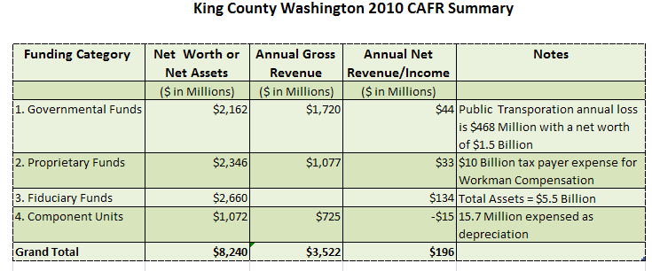
King county wa municipal corporation cafr – consolidated annual financial report vs. property tax taking – part 4 of 8
“Between truth and the search for truth, I opt for the second.”
Bernard Berenson
King County Municipal Corporation of WA Inc. Annual Gross Revenue for 2010 is $3.522 Billion –
The Property Tax Larceny for the same year is $3.428 Billion –is this Unbelievable.
The 2010 Total King County Municipal Corporation property tax takings and pie chart on the previous slide show some $3.428 billion dollars
Then refer to the table to the left. King County Municipal Corporation has a annual gross revenue of some $3.522 billion for the year 2010.
The revenue of King County Municipal Corporation appears to be near identical to the annual property tax larceny grand theft.

Slide 41
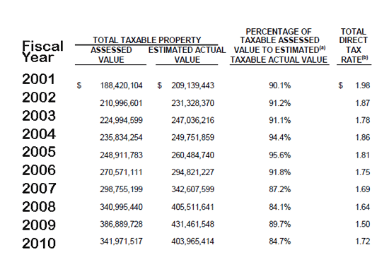
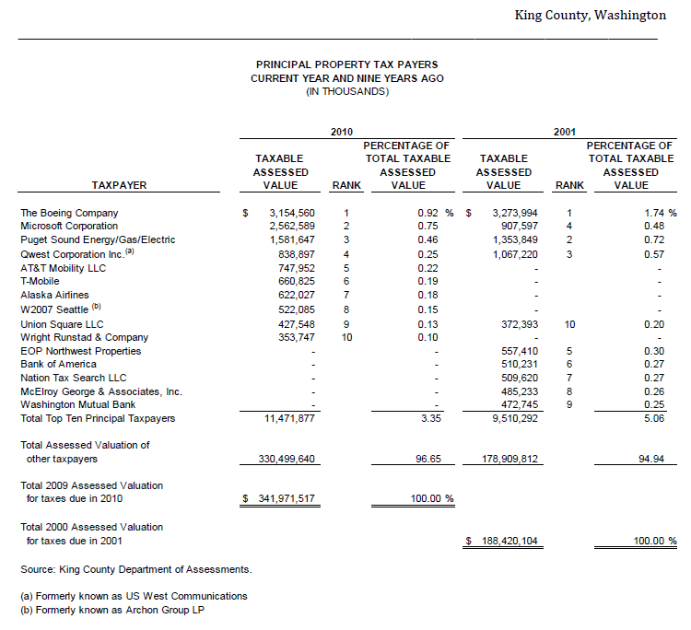
Property tax lies – Part 5 of 8
King County Washington
King County Municipal Corporation Washington
King County Municipal Corp. WA and it’s Municipal Port of Seattle share the same assessment of taking private property. Next slide will show you a similar picture.
The top 15 corporations in King County, table to left, pay only 5% of the total property assessed value. The remaining 95% is paid by smaller business and property owners. Do you get the picture ?
The Total Assessed Valuation of private property has increased 86% over the last 9 years and the Estimated Actual Value has increased 96%. The lowering of the Total Direct Tax Rate does not offset such an increase. The effective increase is about 68% over the last 9 years. Has your salary or business increased this much, of course not.
No family business or property owners can carry this insane level of criminal extortion. Private property and family business are basic unalienable rights NEEDED to survive NOT privileges to be treated as taxable commodities confiscated by the Kings men.

Slide 42
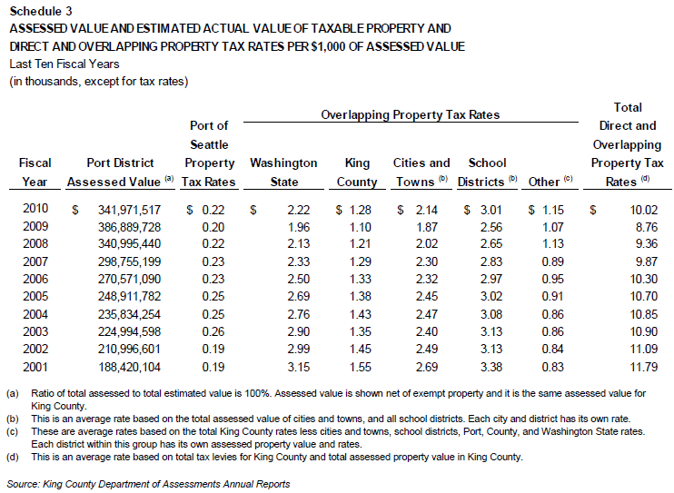
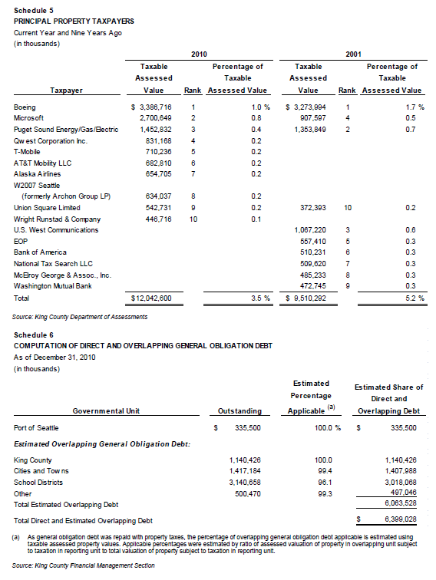
Property tax lies – Part 6 of 8 the port of seattle lie
The ports of Washington handle 8% of all American exports and receive 6% of the nation's imports.^{[9]}
The top 15 corporations in King County, table to left, pay only 5% of the total property assessed value. The remaining 95% is paid by smaller business and property owners. Do you get the picture yet?
It gets worse. The assessed value of King County private property which is the same for the Port of Seattle has increased 82% over the last 9 years and the tax rate of taking has increased 16%. Have your taxes gone down?
The municipal public corporations AND the private corporations have determined that in order for them both to “survive”, they must transfer their gross mismanagement cost of doing “business” onto smaller businesses and property owners. This is how perverted the taking of private property as become by the colluding municipal and private corporations.
What they are not telling you is a single digit income tax on all large corporation in the county could replace property taxes . Property taxes are regressive, feudal and go against the highest fundamental and founding laws of the land including our Christian heritage. Said another way, the public and private sectors of business have no rightful authority or jurisdiction in private affairs of the state Citizen most especially taxing, regulating and charging them usury for basic birthrights of property ownership , labor and family business necessary to survive.

Slide 43
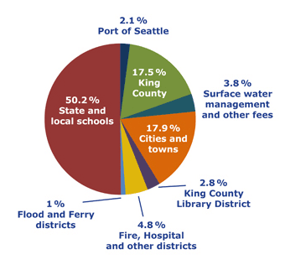

Property tax lies – Part 7 of 8
“Reciting part of a sutra with the desire to benefit others is like reciting a recipe in the hope it will prevent people from starving.”
Basset
King County Washington Municipal Corporation Property Tax Distribution
Every function on this pie chart should be reconstituted into a public coop or a private business based on free choice of the services NOT the embezzlement of private property and the wages of the owners.
American’s Municipal corporations have been allowed to assimilate state Citizens’ family business & property by force they have become so successful hundreds of Muni’s net worth and revenues are larger than many states & private corporations. They have done this by increasing use of needless tyranny and sharing of their spoils of war with their up line and down line states and cities and town municipal corporations. This is a European feudal monarchy & monopoly prohibited after the first American revolution
The city and county municipals are growing wealthy at the expense of the local Citizens. Herein is the data to prove it. They are increasingly more wealthy and bankrupt at the same time.
County and city library systems are highly discretionary & leisure activities that do not belong in the government , let alone on tax tyranny roles. If a community wants a library they can raise the funding through voluntary donations and volunteer labor to build the library.
Fire is an emergency service like wind, hail, volcano, earthquake or flood, NOT a government tax district. All fire departments should be privatized or reorganized into private/public coops pay for use services. These services are paid when they are used at your free choice NOT by forced taxation in monopolies that do not compete. Private insurance covers such disasters with limits & deductibles set by the home or business owner’s comfort zone.
Surface water “management “is not a function of government, this is called Mother nature and limited governments do not “manage” the weather nor force anyone to do so. Limited free republics do not pretend to control the weather, water tables, energy or flooding or the environment by force. If a free market develops supporting a private or public coop in the “water management” that is called “supply and demand” NOT monopolize and penalize.
The Ferry systems are no different than an airline company. The government may not enter into competition with any private or public coop business. Travel is a supply and demand business model not a social welfare model. Public transit systems drive out independent small business competition and transfer that cost many times over to the state Citizens . Governments cannot manage or own any business simply because they cannot compete in a free market in a true and honest free republic. A true and honest free limited Republic sole mission is to keep the game board level and free, not mount it.

Slide 44
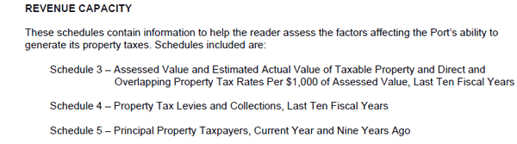
Property tax lies – Part 8 of 8 the port of seattle needs your property taxes lie
The Port of Seattle Needs To Tax Your Property Lie
The Port of Seattle is also a municipal corporation who employees King County Municipal Corporation as its agent. The following data is taken from their 2010 CAFR. “The Port of Seattle is a public enterprise governed by five commissioners “elected” by the citizens of King County. Its mission is to provide services and facilities to accommodate the transportation of cargo and passengers by air , and land. Its marine facilities include one of the largest container ports in the United States. The Port includes Seattle-Tacoma International Airport ..and marinas.. “
The Port corporation has assets of $6.6 billion with annual revenues of near half billion dollars ( $470 million).
The Port of Seattle Municipal Corporation is ranked 37 in tonnage out of 149 ports in America, number one infers rank is highest tonnage.
This Port Muni Corporation assets and revenues are increasing historically with the help of the county and the state municipal corporations.
Even with this massive wealth, this Port Municipal Corporation is allowed to subsidize its near half billion dollar of annual revenue with a private property tax amounting to 16% of its revenue. This is criminal insanity!
Furthermore, over the last 10 years of property tax taking, the assessed value of King County WA has increased 82%, property tax rates have increased 16% and the collections of revenue have increased 102%.
It gets worse. Please refer to the quote from Page 59 of the Port 2010 CAFR (lower left). The State of Washington considers private property of struggling individuals and families as a “Revenue Capacity” and “ability to generate” revenue to keep a multi billion dollar port operation in business! Private property including wages are not taxable, they are unalienable rights not privileges.
Look at Page 20 of the 2010 Port of Seattle CAFR and you can see they are generating enough increases in net assets to eliminate the property tax taking completely over the last three years.
To summarize page 20 CAFR, the Port (Airport & Seaport) had a net profit of $319 million over 2008, 2009 & 2010 while taking in $226, 392 million in property taxes, i.e. THEY DID NOT NEED THE PROPERTY TAXES !
The state Citizens and most especially the property owners have been betrayed. This is another reason why a so called “representative” government does not work. Public employees are ONLY representing themselves while transferring private property & wages to themselves.
South Carolina has a sea port and did away with its taxing of property on businesses, that is one small step for business property kind.
King County Washington Municipal Corporation Property Tax Distribution
i.e. Revenue Capacity IS property taxes to the Port of Seattle Muni. Corporation.

Slide 45
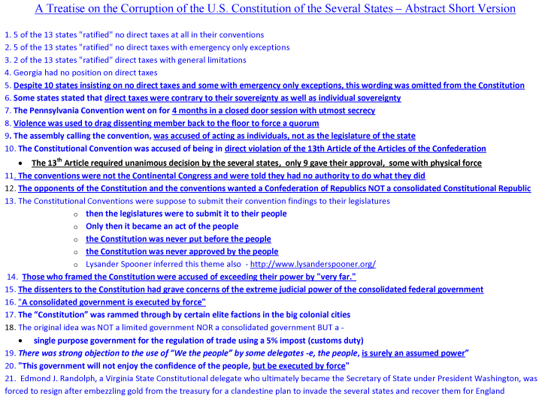
The “united” states constitution that never was -
Key points to understand why confederation and state charters are bylaws limiting public and private corporations not the rightful state sovereign and free citizen.
“In a world of fugitives
The person taking the opposite direction
Will appear to run away.”
T.S. Eliot
It is imperative to understand the following to free yourself and America from the global to local tentacles of entanglement.
The key to unlock our chains is individual free choice, no tax taking, no regulating & no usury upon state Citizens.
No state or municipal corporation can steal property from a rightful sovereign and fee state Citizen let alone buy more private property using such larceny.
America is a confederation of states NOT a centralized monopoly of the states nor a centralized franchise of public city and county municipal corporations.
“Confederation – A league or compact for mutual support, particularly of nations, or states. Such was the colonial government during the Revolution. See Confederacy.” Black’s Law Dictionary Fifth Edition.
The original intent of the first conventions were to amend the Articles of Confederation not to write a new charter centralizing new free republics and commonwealths into the hands of a few, i.e. bait and switch.
No taxing power was given to the confederation or union of colonies in the Articles of Confederation and none is required or legitimate in a true and honest limited free Republic., taxing the sovereign state Citizens is contrary too and an oxymoron to living in a free state.
The American Articles of Confederation required unanimous agreement not a 2/3 agreement as was obtain some by force of the rewritten Articles of Confederation, i.e. the U.S. Constitution.
The Confederation costs were to be apportioned by state population not upon the state Citizen but upon the commerce side of the private sector.
Further research here -http://www.freedomforallseasons.org/ConstitutionThatNeverWas.asp

Slide 46
Property Owners & small family businesses cannot be taxed, taken, regulated or charged usury
“Speech is blasphemy, silence a lie. Above speech and silence there is a way out”
I-Tuan
Americans revolted and shed blood to stop all tax taking upon their individual and family labor and property including regulations and usury.
Jesus stated, “What thinkest thou, Simon? of whom do the kings of the earth take custom or tribute? Of their own children, or of strangers? Peter saith unto him, Of strangers. Jesus saith unto him, Then are the children free”. Matthew 17:24-27 King James Version
The Laws of Nature and Nature’s God encompass our 70 some unalienable rights which are divine birthrights providing sanctuary to all man and most especially those who have been blessed to be born in America. These highest fundamental laws are inviolable, immutable, indisputable, unrestricted, unqualified and absolute.
  http://www.freedomforallseasons.org/NaturalLawAndNaturalRights.asp
  http://www.freedomforallseasons.org/UnalienableRightsNew.asp
The American Declaration of Independence is very clear, the colonists detested British oppression from uncountable fronts, especially taxing of the Citizens (“the children” vs. strangers.)
The American first Revolution intent and success was also very clear that Americans were willing to fight, bleed and if necessary die to take down the monarchy. General Washington and a few thousand frontiersmen and the French Navy won our freedom. However, the British monarchy remained by leaving its barbaric banking system and feudal municipal infrastructure exercised by tyranny not free choice.
There have been at least 53 cases in the Supreme Court and Federal Circuit Court ruling against the taxing of labor and private property.
        Supreme Court Cases re. Taxes on Labor - http://www.voluntarytax.info/Taxes_on_labor.htm
        - Also backed up here
          This documentation lays out 42 U.S. Supreme Court rulings against taking of Labor and Property and 11 Federal Circuit Court Cases
Grand juries must be reinstalled outside of the state and its corrupted strangle hold on individuals so that the state sovereign and free Citizens can prosecute all public officials who are stealing individual and family property owners and small business owners blind, bankrupt and homeless.
Taxes of any kind, regulations of any kind and usury at any level is equivalent to murder and torture and are slow death to the victims and societies they are imposed upon.
All the politicians, banksters and liewyers and their NGO’s have turned against the highest fundamental laws and the children of the land to expand their kingdoms beyond the limited basic community sewer and power infrastructures.
The history of the rights of man show this same pattern of denial to free man from tyranny, e.g. child labor, slavery, women suffrage, soldiers rights, human rights, property rights, etc.
Free limited Republics do not debate unalienable rights let alone take them, they protect them at any cost.
In the history of enslavement of others through tyranny and war there is one common denominator and that is the justification of taking and forcing upon others for another’s profit and power, i.e. the self righteous and arrogant takings debased on thinking the equivalent of a utility sewer maintenance public servant knows more than the sovereign Citizen.

Slide 47
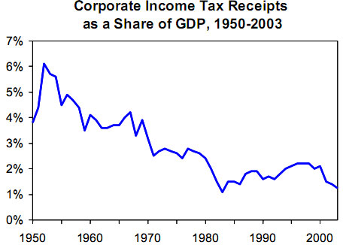
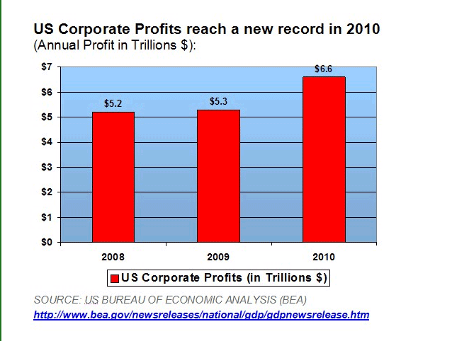
The public and private corporation handshake at the expense of the property and wage owners
Summary of this slide and following two:
U.S. Corporate income tax collections are declining relative to GDP.
U.S. Corporation profits reached a new record in 2010.
Public municipal corporations net worth and revenues are accelerating through private property and wage takings using tyrannical regulatory and usury (debt) debased on lies. Nearly every “enterprise” business the Muni Corps. take over operates at a loss which is passed on to the property owners of which the vast majority do not use, e.g. land holdings for environmental rights.
Individuals pay 12 - 14% of Wages, (Private Property) for 85 to 91% of Federal Taxes.
Currently 1% of Corporate Revenue Pays only 9 - 15% of Federal Taxes
Individual Federal taxes can be replaced by a 12 - 14% tax on Corporate Revenue
Currently only 0.17% of Corporate Revenue Pays State Taxes
Currently 5.18% of Individual Payroll (Wages) Pay State Taxes
American Individual total tax taking averages 29.3% with the 2013 tax free day April 18.
There is only 30 days difference between the highest and lowest tax taking state, i.e. it’s a global to local property taking franchise.
Individual state taxes can be replaced by a 1.04% on state Corporate Revenue
All taxes are ultimately paid by the consumer when they purchase goods and services by free choice so individuals are taxed unnecessarily many times over, i.e. compounded wages and property taking.
Deceit. Inc. (D.C.) and its 50 states and their private and public municipalities are all corporations not true and honest free limited Republics.
Property and wage taking by force is regressive, not necessary, encourages more property and wage theft and centralizes the dark powers. Like King Collectivist County, the more they take, the more they take because there is no free choice and no debate of the taking and no vote by those being taken.
The answer to stop all of this larceny is individual free choice which is true and honest freedom and liberty to control your individual birthrights.
Click on chart to link to report

Slide 48
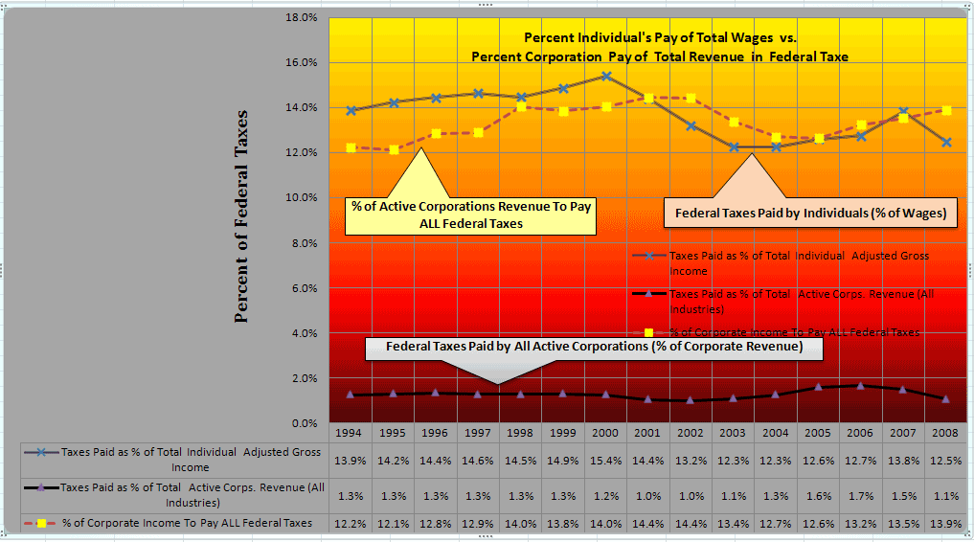
The IRS, “Federal Reserve and other taxing lies (cont.)
Summary of Part 1 and 2 Graphs
Currently 12 to 14% of Wages Pay 85 to 91% of Federal Taxes
Currently 1 % of Corporate Revenue Pay 9 to 15% of Federal Taxes
Individual Federal taxes can be replaced by a 12 to 14% tax on Corporate Revenue
Currently .17% of Corporate Revenue Pays State Taxes
Currently 5.18% of Individual Payroll (Wages) Pays State Taxes
Individual State taxes can be replaced by a 1.04% on Corporate Revenue
All taxes are ultimately paid by the consumer
American natural born and rightfully naturalized cannot be compelled to pay any kind of taxes otherwise they would be slaves.
American Citizens are clearly sovereign and the government is clearly NOT.
Government may rightfully compel artificial legal fiction corporations to pay reasonable uniform percent of tax as they are man made & unnatural .
All taxes may be rightfully shifted to the corporations who in turn may transfer this cost in their pricing, profit and dividends.
The tax is paid by corporations FROM PROFIT AND/OR when the American Citizen purchases the products or services BY FREE CHOICE.
Eliminate usury and government regulations & the above 14% direct tax on corporations would be a single digit.
No taxes of any kind are necessary or legitimate upon American Citizens, i.e. taxing is used as social engineering and herd control .
All taxes could be paid by this method, i.e. this is a sales tax on the corporations, NOT a till tax on the Citizens, NOT a property tax on the property owner, NOT a federal or state income tax on the state natural born Citizen, NOT a estate tax on the life long wealth of the natural born or his/her heirs ,NOT a sales tax on the Citizens .
TAXES UPON AMERICAN CITIZENS ARE NOT NECESSARY.

Slide 49
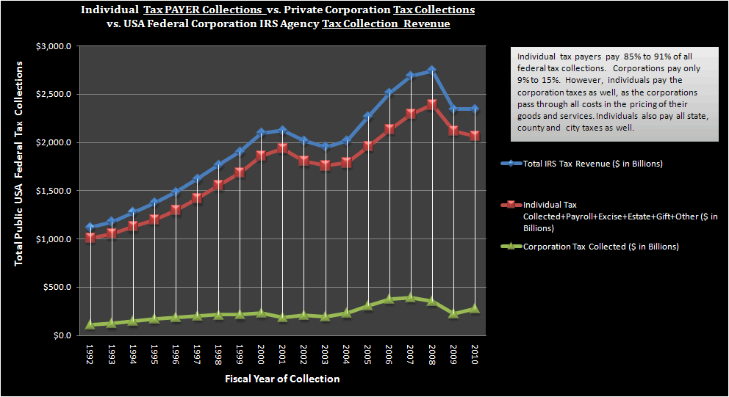
The IRS, “Federal Reserve and other taxing lies (Cont.)
1895: Pollack v. Farmer's Loan and Trust Company, 157 U.S. 429, 158 U.S. 601. Prohibits direct taxes on the income of individuals.
Summary of Part 1 and 2 Graphs
Currently 12 to 14% of Wages Pay 85 to 91% of Federal Taxes
Currently 1 % of Corporate Revenue Pay 9 to 15% of Federal Taxes
Individual Federal taxes can be replaced by a 12 to 14% tax on Corporate Revenue
Currently .17% of Corporate Revenue Pays State Taxes
Currently 5.18% of Individual Payroll (Wages) Pays State Taxes
Individual State taxes can be replaced by a 1.04% on Corporate Revenue
All taxes are ultimately paid by the consumer
Link here to fully understand “Why Private Property and Wages Cannot Be Taxed, Taken, Regulated or Charged Usury”
This chart shows IRS tax collections on individual tax payers vs. USA corporations:
a. Individuals pay 85 to 95% of the TOTAL federal tax
b. Corporations pay only 9 to 15% of the TOTAL federal tax
Individuals actually pay ALL taxes because corporations are just pass through legal fiction transfer entities.
The 9 to 15% of federal taxes which American corporations "pay" are passed through in their pricing of goods and services.
Import taxes are ALSO ultimately paid by individuals because the country who is taxed transfers the tax onto their exports, Lysander Spooner noted this in his writings in the mid 1800’s as well.
Forced taxes on individuals are unnecessary because individuals pay all taxes when they purchase corporate goods and services BY FREE CHOICE.
www.CAFR!.com makes the case governments hold so much net worth, they can fund limited gvt. on investments alone.

Slide 50
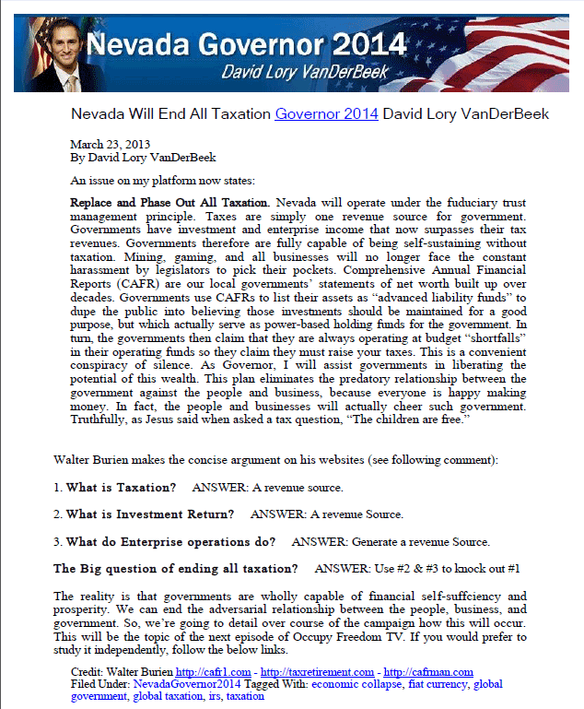

End all tax taking
12 Worst Corporate Tax Dodgers - http://realwashingtonstatebudget.info/index.php?option=com_content&view=article&id=64&Itemid=80
Corporate Tax Revenues At Historic Lows

Slide 51

How bad is the taking of property and small businesses by petty political municipal monopolies –
Institute of justice fights for property and business rights
And this is just the tip of the iceberg of taking by local to global municipal cartel.
These are the lucky property owners and small business owners who had the Institute of Justice to ride to their rescue often for pro bono.

Slide 52
About Jack
“To be surprised, to wonder, is to begin to understand.”
Jose Ortega Y Gasset
www.FreedomForAllSeasons.org - Table of Contents
1. Mission Statement
2. Natural Law & Natural Rights
3. Unalienable Rights vs. Inalienable Rights
4. Organic Laws of The United States of America
5. The British Common Law
6. The U.S. Constitution That Never Was
7. Current Property Battles -Taking Back Our Rights
8. Freedom From Alternative Energy Myths
9. Freedom From Critical Area Ordinances Myths
10. Freedom From Fish Myths
11. Freedom From Endangered Species Mythomania
12. Freedom From Environmental Extremism
13. Freedom From Government Cover Ups - The 9-11 Hot Engineering Facts
14. Freedom From Government Roundabout Nonsense For Humans & Fish
15. Freedom From Illegal Aliens in Government
16. Freedom From "Man Caused" Global Warming Myths
17. Freedom From Rails To Trails Takings
18. Freedom From Rural Cleansing BY Global To Local UN Agenda 21
19. Freedom From The State of Washington Constitution That Never Was
20. Freedom To Keep & Bear Arms
21. Freedom From ALL Tax Takings Upon The Natural Born State Citizens
22. Freedom To Own Land With Allodial Rights
23. Freedom To Own Property W/O TYRANNY - Embattled Owner Stories
24. Freedom From The unFederal unReserve
25. Freedom From King County WA Municipal Corporation - The Great Imposter
26. Must Read Must Subscribe Must Support Must See
27. Freedom From Water Takings
28. Freedom From De Facto Laws (New)
29. Freedom From Municipal Corporations, i.e. Evil Empires
30. Freedom From The Trilogy of Taking (New)
31. Freedom From Park Takings (New)
32. Freedom From Mainstream Media Monopoly Lies (New)
33. Jack's Prose From The Heart
34. About Jack
Jack Venrick
Rollins, Montana
Pioneer Family of Montana
Pioneer Family of Nebraska
Pioneer Family of Wisconsin
The Boeing Company 30 Years Service - Retired
Montana State University
B.S. Electrical Engineering
M.S. Applied Science –
Industrial Engineering
Business Administration

